Slide 1
CS1005- Discrete Structures Fall 25
Mr. Shoaib Raza Lecturer

Slide 2
Course Outline
Logic and Proofs
Sets and Functions
Sequences and Series
Relations
Number Theory
Proof techniques
Induction and Recursion
Counting and Recurrence Relations
Graphs
Trees

Slide 3
TEXT Book:
Discrete Mathematics & its Applications, 8th edition. By Kenneth H. Rosen.
References Book:
Invitation to Discrete Maths, 2nd edition. By Matousek and Nesetril.
Discrete Mathematics. By Lovasz, Pelikan and Vesztergombi.

Slide 4
The Foundations: Logic and Proofs
Chapter 1, Part I: Propositional Logic
Mr. Shoaib Raza

Slide 5
Discrete Mathematics
Discrete mathematics is the part of mathematics devoted to the study of discrete objects (Kenneth H. Rosen, 8th edition).
How to think (and argument) mathematically.
Learn mathematical facts and their applications.
Discrete mathematics is the mathematical study of properties, and relationships among discrete objects.
Discrete mathematics is the study of mathematical structures that are fundamentally discrete rather than continuous.

Slide 6
Discrete Vs Continuous
Continuous Data: A set of data is said to be continuous if the values belonging to the set can take on any value within a finite or infinite interval.
Continuous data is information that can be measured on a continuum or scale. , e.g., [ 0, 70].
Continuous data can have almost any numeric value and can be meaningfully subdivided into finer and finer increments, depending upon the precision of the measurement system.
Discrete Data: A set of data is said to be discrete if the values belonging to the set are distinct and separate. It is counted e.g., {1,2,3,4,5,6}

Slide 7
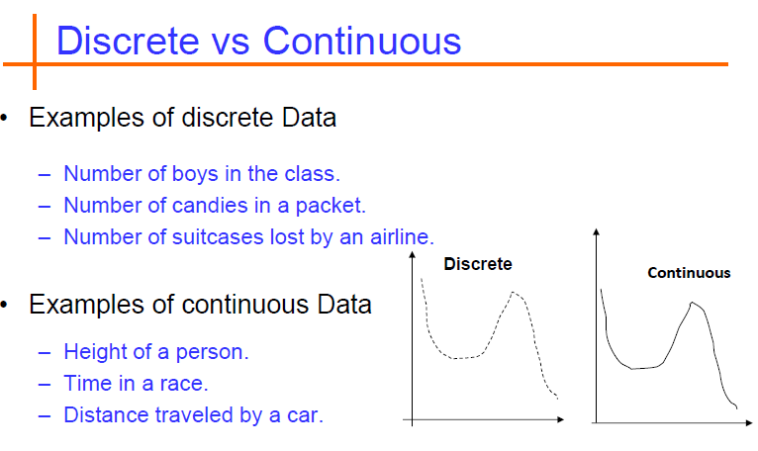

Slide 8
Why DM?
Digital computers are based on discrete “atoms” (bits).
Therefore, both a computer’s
structure (circuits) and
operations (execution of algorithms)
can be described by discrete mathematics.

Slide 9
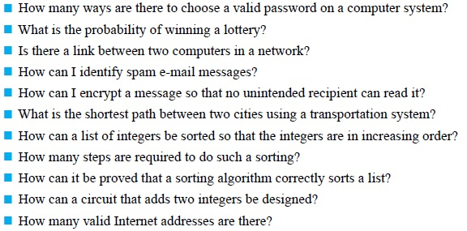
Applications

Slide 10
Course Description:
This class teaches students
how to think logically and mathematically.
It stresses mathematical reasoning and different ways to solve problems.
It enhance your ability to formulate and solve applied problems, to analyze and interpret algorithms and functions and to use them effectively.
Five important themes are interwoven in this class:
mathematical reasoning,
combinatorial analysis,
discrete structures,
algorithmic thinking,
applications and modeling

Slide 11
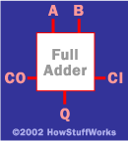
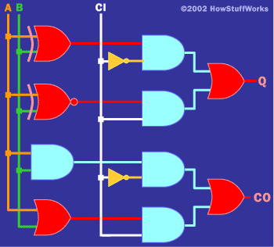
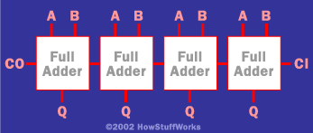
Applications: Logic Hardware and software specifications
Formal: Input_wire_A
value in {0, 1}
Example 1: Adder
One-bit Full Adder with
Carry-In and Carry-Out
4-bit full adder
Example 2: System Specification:
The router can send packets to the edge system only if it supports the new address space.
For the router to support the new address space it’s necessary that the latest software release be installed.
The router can send packets to the edge system if the latest software release is installed.
The router does not support the new address space.
How to write these specifications in a rigorous / formal way? Use Logic

Slide 12
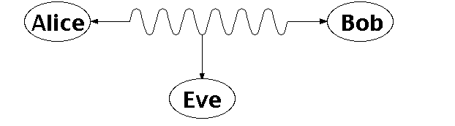
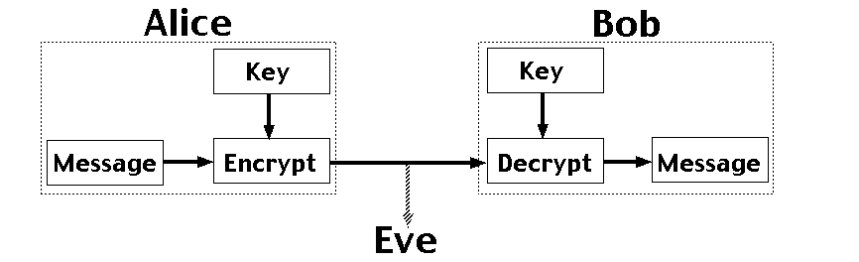
Applications: Number Theory RSA and Public-key Cryptography
Alice and Bob have never met but they would like to
exchange a message. Eve would like to eavesdrop.
E.g. between you and the Bank of America.
They could come up with a good encryption algorithm and exchange the encryption key – but how to do it without
Eve getting it? (If Eve gets it, all security
is lost.)
CS folks found the solution:
public key encryption. Quite remarkable
that is feasible.
Notes:
One solution is for Alice and Bob to exchange a digital key, so they both know it, but it's otherwise secret. Alice uses this key to encrypt messages she sends, and Bob reconstructs the original messages by decrypting with the same key. The encrypted messages (ciphertexts) are useless to Eve, who doesn't know the key, and so can't reconstruct the original messages. With a good encryption algorithm, this scheme can work well, but exchanging the key while keeping it secret from Eve is a problem. This really requires a face to face meeting, which is not always practical.

Slide 13

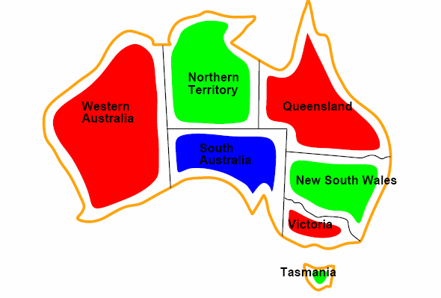

Applications: Coloring a Map
How to color this map so that no two
adjacent regions have the same color?

Slide 14
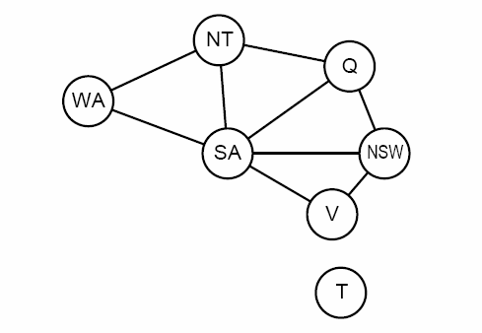
Applications: Graph representation
Coloring the nodes of the graph:
What’s the minimum number of colors such that any two nodes
connected by an edge have different colors?

Slide 15
Logic
Logic is fundamental because it allows us to understand meaning of statements, deduce information about mathematical structures and uncover further structures.
The rules of logic specify the meaning of mathematical statements.
These rules are used to distinguish between valid and invalid arguments.

Slide 16
Propositional Logic
Introduction
A proposition is a declarative sentence (a sentence that declares a fact) that is either true or false, but not both.
Are the following sentences propositions?
Islamabad is the capital of Pakistan.
Read this carefully.
1+2=3
x+1=2
What time is it?
(Yes)
(No)
(Yes)
(No)
(No)

Slide 17
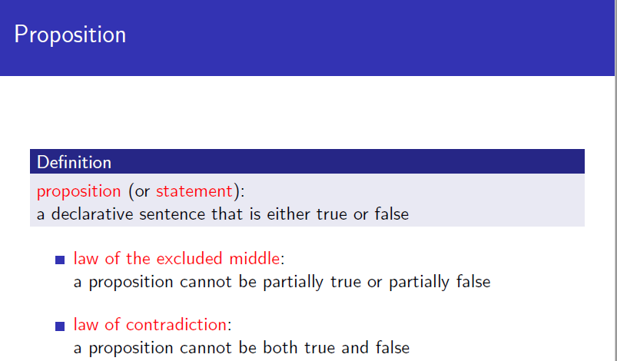
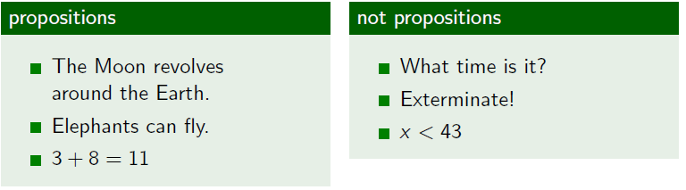

Slide 18
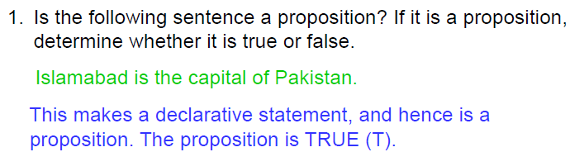
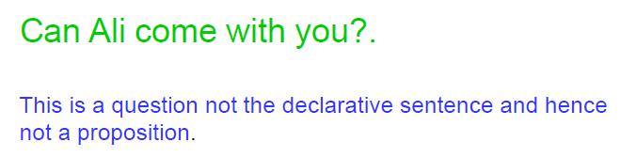
Examples: Propositions

Slide 19
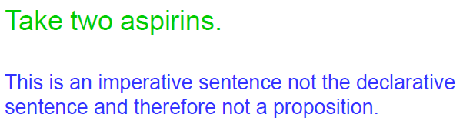
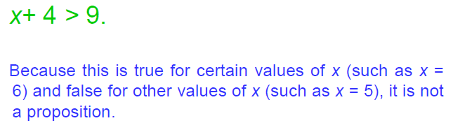
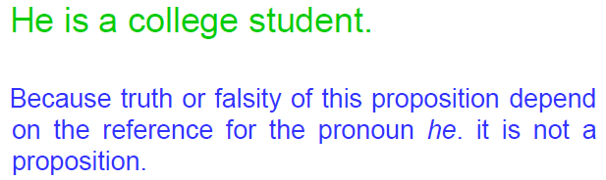

Slide 20

Activity 1
Write down at least 5 examples of propositions and
Non-propositions.

Slide 21
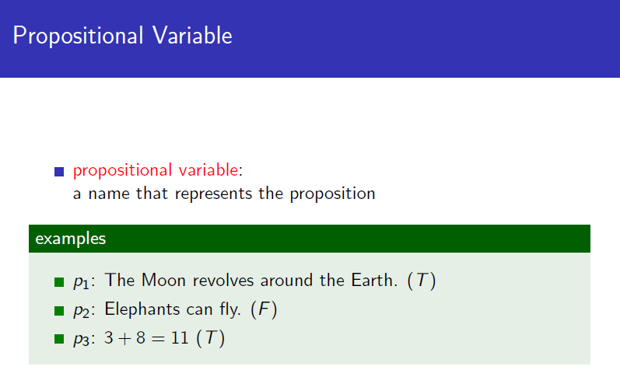
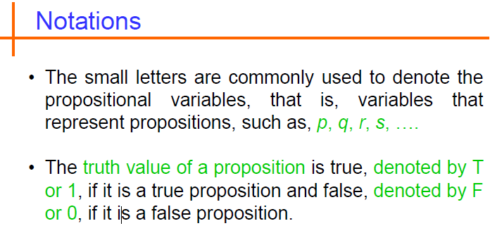

Slide 22
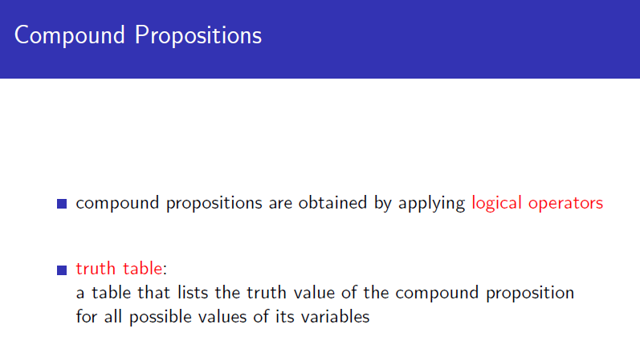
Logical operators are used to form new propositions also called compound propositions from two or more existing propositions.
The logical operators are also called connectives.
Propositional Logic – the area of logic that deals with propositions

Slide 23
1. Negation:
DEFINITION 1:
Let p be a proposition. The negation of p, denoted by ¬p, is the statement “It is not the case that p.”
The proposition ¬p is read “not p.” The truth value of the negation of p, ¬p is the opposite of the truth value of p.
Examples
Find the negation of the proposition “Today is Friday.” and express this in simple English.
Find the negation of the proposition “At least 10 mm of rain fell today in Karachi.” and express this in simple English.
Solution: The negation is “It is not the case that today is Friday.” In simple English, “Today is not Friday.” or “It is not Friday today.”
Solution: The negation is “It is not the case that at least 10 mm of rain fell today in Karachi.” In simple English, “Less than 10 mm of rain fell today in Karachi.”

Slide 24
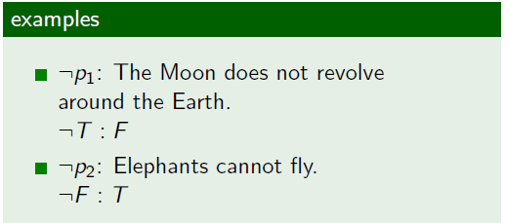
Negation:
Note: Always assume fixed times, fixed places, and particular people unless otherwise noted.
Truth table:
The Truth Table for the Negation of a Proposition.
p | ¬p
T F | F T

Slide 25
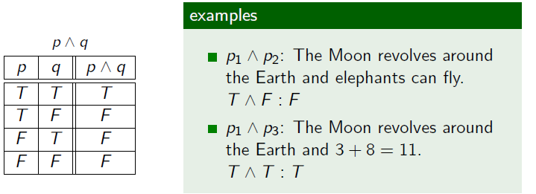
2. Conjunction:
DEFINITION 2
Let p and q be propositions. The conjunction of p and q, denoted by p Λ q, is the proposition “p and q”. The conjunction p Λ q is true when both p and q are true and is false otherwise.
Examples
Find the conjunction of the propositions p and q where p is the proposition “Today is Friday.” and q is the proposition “It is raining today.”, and the truth value of the conjunction.
Solution: The conjunction is the proposition “Today is Friday and it is raining today.” The proposition is true on rainy Fridays.

Slide 26
3. Disjunction:
DEFINITION 3
Let p and q be propositions. The disjunction of p and q, denoted by p ν q, is the proposition “p or q”. The disjunction p ν q is false when both p and q are false and is true otherwise.
Note:
inclusive or : The disjunction is true when at least one of the two
propositions is true.
E.g. “Students who have taken calculus or computer science can take this class.” – those who take one or both classes.
exclusive or : The disjunction is true only when one of the
proposition is true.
E.g. “Students who have taken calculus or computer science, but not both, can take this class.” – only those who take one of them.
Definition 3 uses inclusive or.

Slide 27
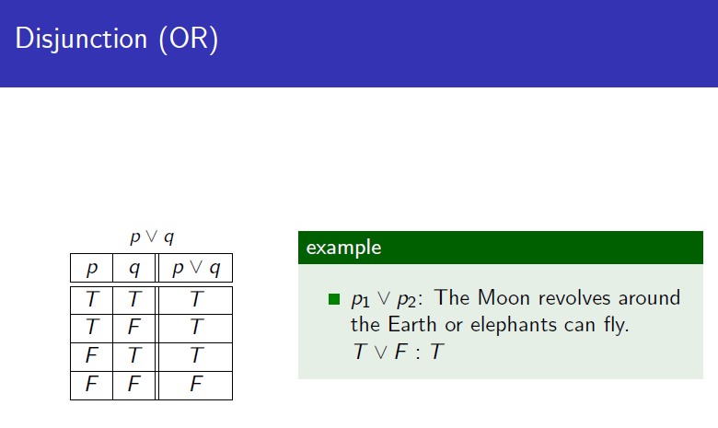

Slide 28


4. Exclusive OR:
DEFINITION 4
Let p and q be propositions. The exclusive or of p and q, denoted by p q, is the proposition that is true when exactly one of p and q is true and is false otherwise.
The Truth Table for the Conjunction of Two Propositions.
p q | p Λ q
T T T F F T F F | T F F F
The Truth Table for the Disjunction of Two Propositions.
p q | p ν q
T T T F F T F F | T T T F
The Truth Table for the Exclusive Or (XOR) of Two Propositions.
p q | p q
T T T F F T F F | F T T F

Slide 29
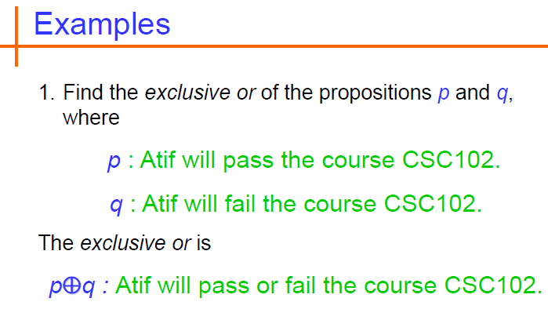
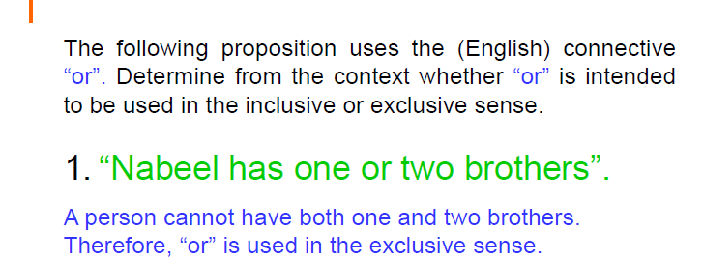

Slide 30
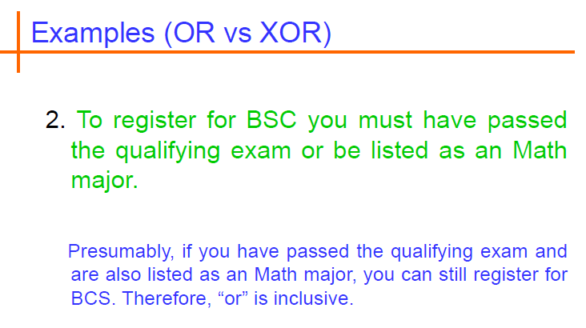

Slide 31
5. Implication / Conditional Statements:
DEFINITION 5
Let p and q be propositions. The conditional statement p → q, is the proposition “if p, then q.” The conditional statement p → q is false when p is true and q is false, and true otherwise. In the conditional statement p → q, p is called the hypothesis (or antecedent or premise) and q is called the conclusion (or consequence).
A conditional statement is also called an implication.
Example: “If I am elected, then I will lower taxes.” p → q
implication:
elected, lower taxes. T T | T
not elected, lower taxes. F T | T
not elected, not lower taxes. F F | T
elected, not lower taxes. T F | F

Slide 32
Example: Conditional Statements
Example:
Let p be the statement “Maria learns discrete mathematics.” and q the statement “Maria will find a good job.” Express the statement p → q as a statement in English.
Solution: Any of the following -
“If Maria learns discrete mathematics, then she will find a good job.
“Maria will find a good job when she learns discrete mathematics.”
“For Maria to get a good job, it is sufficient for her to learn discrete mathematics.”
“Maria will find a good job unless she does not learn discrete mathematics.”

Slide 33
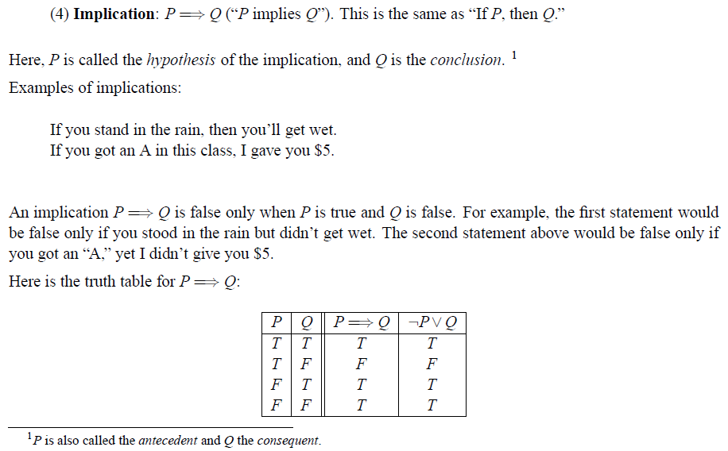
Examples: Implication

Slide 34
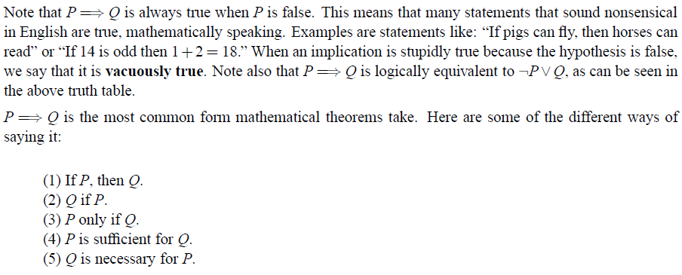
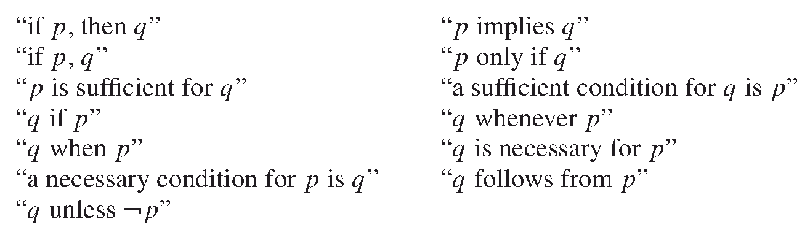
Examples: Implication
Some other cases of implications:

Slide 35
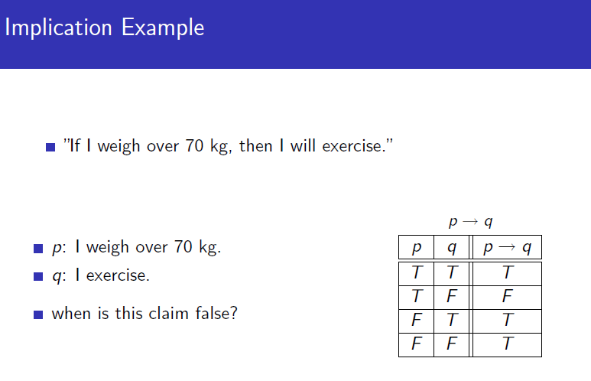
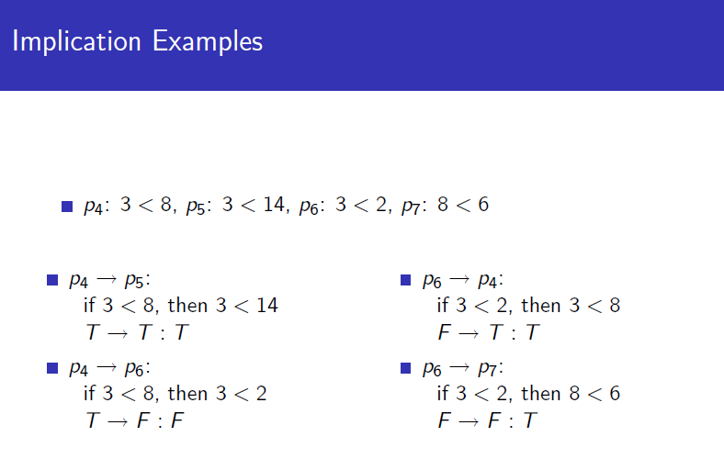

Slide 36
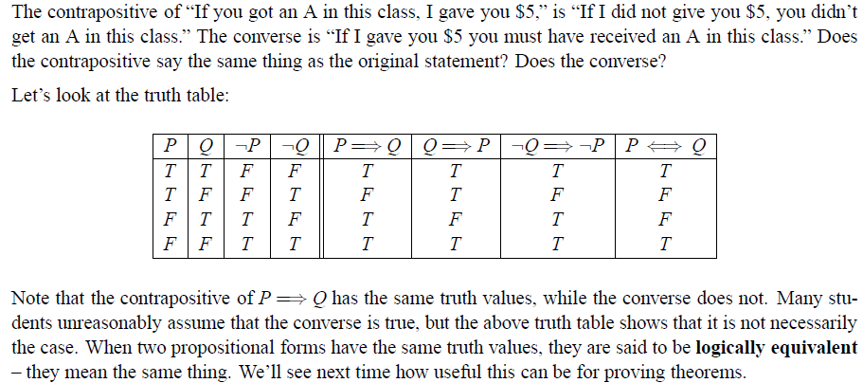
Other conditional statements:
Converse of p → q : q → p
Contrapositive of p → q : ¬ q → ¬ p
Inverse of p → q : ¬ p → ¬ q

Slide 37
Converse, Contrapositive, and Inverse
From p →q we can form new conditional statements .
q →p is the converse of p →q
¬q → ¬ p is the contrapositive of p →q
¬ p → ¬ q is the inverse of p →q
Example: Find the converse, inverse, and contrapositive of “It is raining is a sufficient condition for my not going to town.”
Solution:
converse: If I do not go to town, then it is raining.
inverse: If it is not raining, then I will go to town.
contrapositive: If I go to town, then it is not raining.

Slide 38
Contrapositive:
Contrapositive of p → q is ¬q → ¬p
Any proposition and its contrapositive are logically equivalent (have the same truth table values) – Check with the truth table.
E.g. The contrapositive of “If you get 100% in this course, you will get an A+” is “If you do not get an A+ in this course, you did not get 100%”.

Slide 39
Converse:
Converse of p → q is q → p
Both are not logically equivalent.
Ex 1: “If you get 100% in this course, you will get an A+” and “If you get an A+ in this course, you scored 100%” are not equivalent.
Ex 2: If you won the lottery, you are rich.

Slide 40
Inverse:
Inverse of p → q is ¬p → ¬q
Both are not logically equivalent.
Ex1 : “If you get 100% in this course, you will get an A+” and “If you didn’t 100%, then won’t have an A+ in this course.” are not equivalent.
Ex2: You can not ride the roller coaster if you are under 4 feet. What is its inverse statement?

Slide 41
Example of converse (1/2)
Find the converse of the following statement:
R: ‘Raining tomorrow is a sufficient condition for my not going to town.’
Step 1: Assign propositional variables to
component propositions
P: It will rain tomorrow
Q: I will not go to town

Slide 42
Example of converse (2/2)
Step 2: Symbolize the assertion R: P → Q
Step 3: Symbolize the converse Q → P
Step 4: Convert the symbols back into words
‘If I don’t go to town then it will rain tomorrow’ or
‘Raining tomorrow is a necessary condition for my not going to town.’ or
‘My not going to town is a sufficient condition for it raining tomorrow.’

Slide 43
6. Bi-implications:
DEFINITION 6
Let p and q be propositions. The biconditional statement p ↔ q is the proposition “p if and only if q.” The biconditional statement p ↔ q is true when p and q have the same truth values, and is false otherwise. Biconditional statements are also called bi-implications.
p ↔ q has the same truth value as (p → q) Λ (q → p)
“if and only if” can be expressed by “iff”
Example:
Let p be the statement “You can take the flight” and let q be the statement “You buy a ticket.” Then p ↔ q is the statement
“You can take the flight if and only if you buy a ticket.”
Implication:
If you buy a ticket you can take the flight.
If you don’t buy a ticket you cannot take the flight.

Slide 44
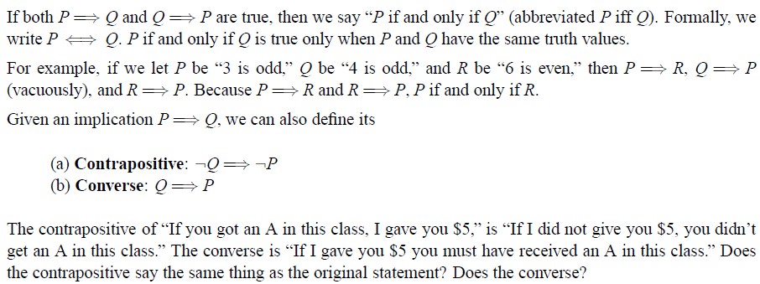
Bi-implications:
If p denotes “I am at home.” and q denotes “It is raining.” then p ↔q denotes “I am at home if and only if it is raining.”
The Truth Table for the Biconditional p ↔ q.
p q | p ↔ q
T T T F F T F F | T F F T
Notes:
ODD 1, 3, 5, 7
Even 2, 4, 6, 8

Slide 45
Expressing the Biconditional
Some alternative ways “p if and only if q” is expressed in English:
p is necessary and sufficient for q
if p then q , and conversely
p iff q

Slide 46
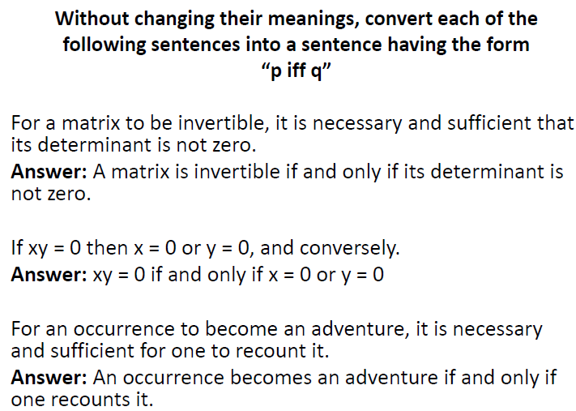

Slide 47
Truth Tables of Compound Propositions
We can use connectives to build up complicated compound propositions involving any number of propositional variables, then use truth tables to determine the truth value of these compound propositions.
Example: Construct the truth table of the compound proposition
(p ν ¬q) → (p Λ q).
The Truth Table of (p ν ¬q) → (p Λ q).
p q | ¬q | p ν ¬q | p Λ q | (p ν ¬q) → (p Λ q)
T T T F F T F F | F T F T | T T F T | T F F F | T F T F

Slide 48
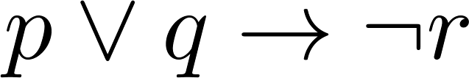
Example Truth Table
Construct a truth table for
p | q | r | ¬r | p ∨ q | p ∨ q → ¬r
T | T | T | F | T | F
T | T | F | T | T | T
T | F | T | F | T | F
T | F | F | T | T | T
F | T | T | F | T | F
F | T | F | T | T | T
F | F | T | F | F | T
F | F | F | T | F | T

Slide 49
Problem:
How many rows are there in a truth table with n propositional variables?
Solution: 2^{n} We will see how to do this in Chapter 6.
Note that this means that with n propositional variables, we can construct 2^{n} distinct (i.e., not equivalent) propositions.

Slide 50
Precedence of Logical Operators
We can use parentheses to specify the order in which logical operators in a compound proposition are to be applied.
To reduce the number of parentheses, the precedence order is defined for logical operators.
Precedence of Logical Operators.
Operator | Precedence
¬ | 1
Λ ν | 2 3
→ ↔ | 4 5
E.g. ¬p Λ q = (¬p ) Λ q
p Λ q ν r = (p Λ q ) ν r
p ν q Λ r = p ν (q Λ r)

Slide 51
Translating English Sentences
English (and every other human language) is often ambiguous. Translating sentences into compound statements removes the ambiguity.
Example: How can this English sentence be translated into a logical expression?
“You cannot ride the coaster if You are under 4 feet tall and you are not older than 16 Years old.”
Solution: Let q, r, and s represent “You can ride the roller coaster,”
“You are under 4 feet tall,” and “You are older than
16 years old.” The sentence can be translated into:
(r Λ ¬ s) → ¬q.

Slide 52
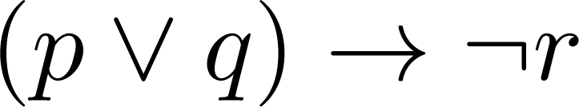
Translating English Sentences
Steps to convert an English sentence to a statement in propositional logic
Identify atomic propositions and represent using propositional variables.
Determine appropriate logical connectives
“If I go to Harry’s or to the country, I will not go shopping.”
p: I go to Harry’s
q: I go to the country.
r: I will go shopping.
If p or q then not r.

Slide 53
Translating English Sentences
Example: How can this English sentence be translated into a logical expression?
“You can access the Internet from campus only if you are a
computer science major or you are not a freshman.”
Solution: Let a, c, and f represent “You can access the Internet from
campus,” “You are a computer science major,” and “You are
a freshman.” The sentence can be translated into:
a → (c ν ¬f ).

Slide 54
System Specifications
System and Software engineers take requirements in English and express them in a precise specification language based on logic.
Example: Express in propositional logic:
“The automated reply cannot be sent when the file system is full”
Solution: One possible solution: Let p denote “The automated reply can be sent” and q denote “The file system is full.”
q→ ¬ p

Slide 55
1.1 Propositional Logic
Logic and Bit Operations
Computers represent information using bits.
A bit is a symbol with two possible values, 0 and 1.
By convention, 1 represents T (true) and 0 represents F (false).
A variable is called a Boolean variable if its value is either true or false.
Bit operation – replace true by 1 and false by 0 in logical operations.
Table for the Bit Operators OR, AND, and XOR.
x | y | x ν y | x Λ y | x y
0 0 1 1 | 0 1 0 1 | 0 1 1 1 | 0 0 0 1 | 0 1 1 0

Slide 56
1.1 Propositional Logic
DEFINITION 7
A bit string is a sequence of zero or more bits. The length of this string is the number of bits in the string.
Example: Find the bitwise OR, bitwise AND, and bitwise XOR of the bit string 01 1011 0110 and 11 0001 1101.
Solution:
01 1011 0110
11 0001 1101 ------------------- 11 1011 1111 bitwise OR 01 0001 0100 bitwise AND 10 1010 1011 bitwise XOR

Slide 57
Propositional Equivalences
DEFINITION 1
A compound proposition that is always true, no matter what the truth values of the propositions that occurs in it, is called a tautology.
A compound proposition that is always false is called a contradiction.
A compound proposition that is neither a tautology or a contradiction is called a contingency.
Examples of a Tautology and a Contradiction.
p | ¬p | p ν ¬p | p Λ ¬p
T F | F T | T T | F F

Slide 58
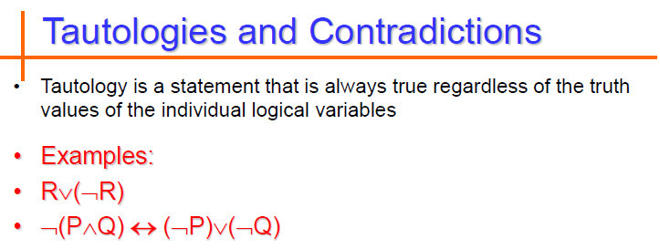

Slide 59
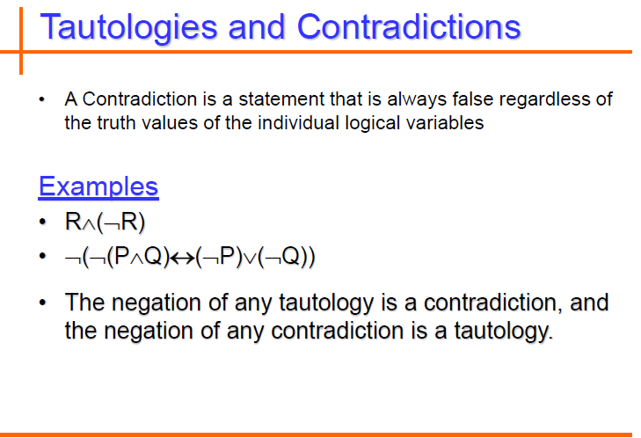

Slide 60
Propositional Equivalences
DEFINITION 2
The compound propositions p and q are called logically equivalent if p ↔ q is a tautology. The notation p ≡ q denotes that p and q are logically equivalent.
Compound propositions that have the same truth values in all possible cases are called logically equivalent.
Example: Show that ¬p ν q and p → q are logically equivalent.
Truth Tables for ¬p ν q and p → q .
p | q | ¬p | ¬p ν q | p → q
T T F F | T F T F | F F T T | T F T T | T F T T

Slide 61
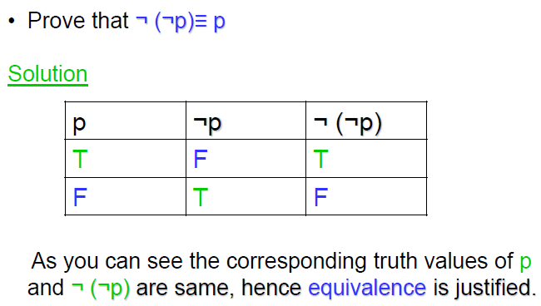
Propositional Equivalences
In general, 2^{n} rows are required if a compound proposition involves n propositional variables in order to get the combination of all truth values.

Slide 62
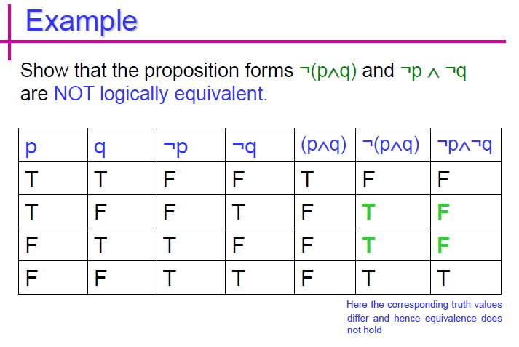
Propositional Equivalences

Slide 63
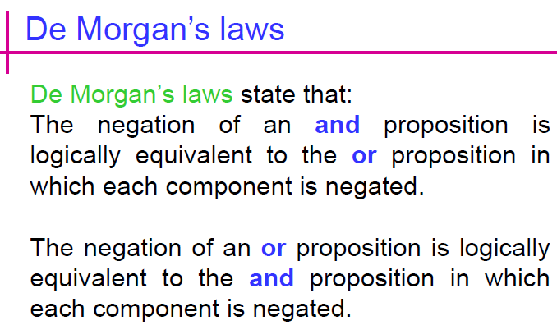
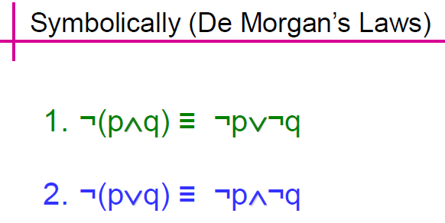

Slide 64
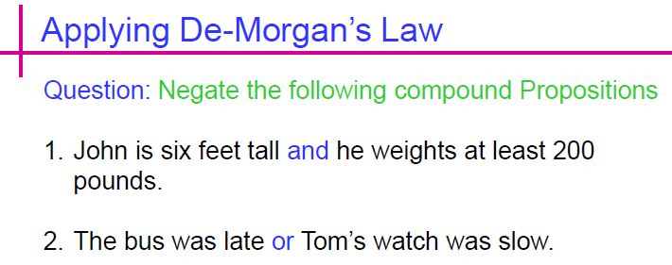

Slide 65
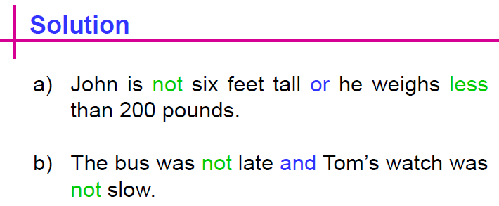

Slide 66
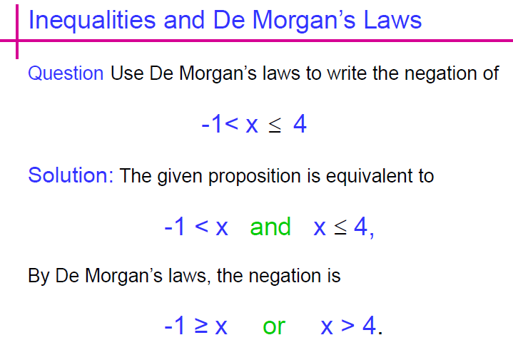

Slide 67
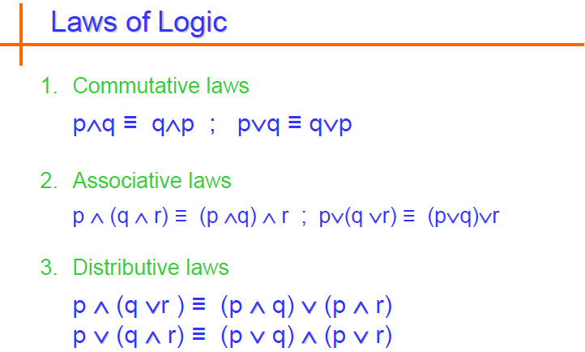

Slide 68
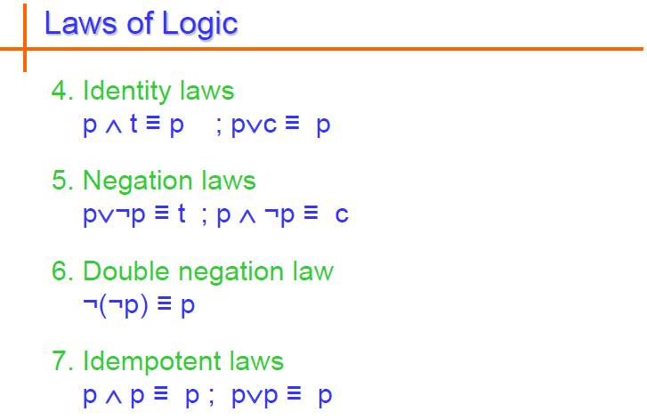

Slide 69
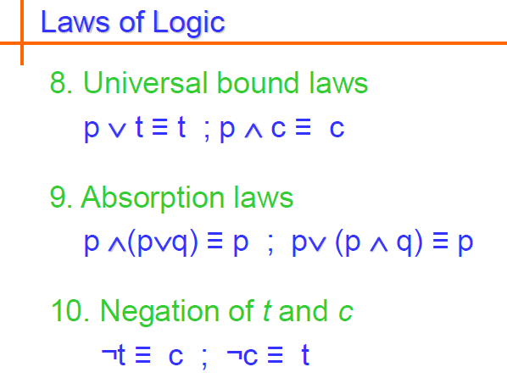

Slide 70
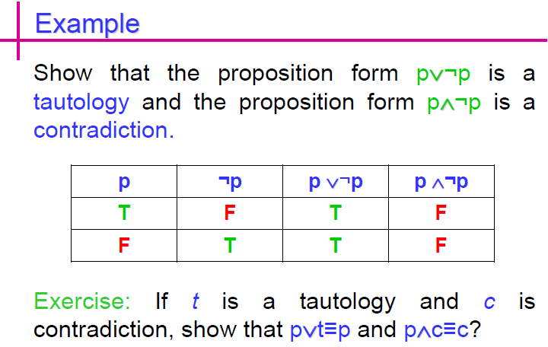

Slide 71
Propositional Equivalences
Constructing New Logical Equivalences
Example: Show that ¬(p → q ) and p Λ ¬q are logically equivalent.
Solution:
¬(p → q ) ≡ ¬(¬p ν q) by example discussed in slide 66
≡ ¬(¬p) Λ ¬q by the second De Morgan law
≡ p Λ ¬q by the double negation law
Example: Show that (p Λ q) → (p ν q) is a tautology.
Solution: To show that this statement is a tautology, we will use logical equivalences to demonstrate that it is logically equivalent to T.
(p Λ q) → (p ν q) ≡ ¬(p Λ q) ν (p ν q) by example already discussed
≡ (¬ p ν ¬q) ν (p ν q) by the first De Morgan law
≡ (¬ p ν p) ν (¬ q ν q) by the associative and communicative law for disjunction
≡ T ν T
≡ T
Note: The above examples can also be done using truth tables.

Slide 72
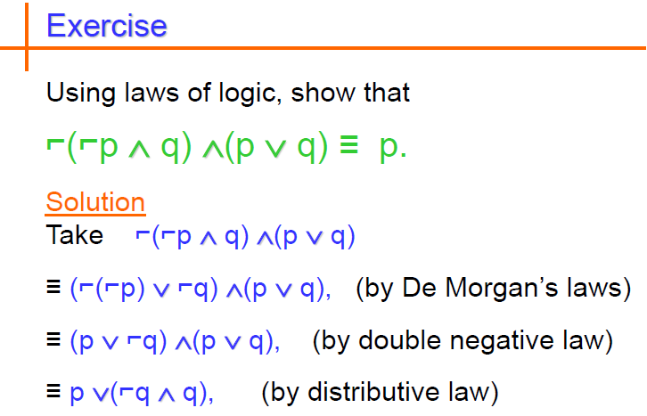
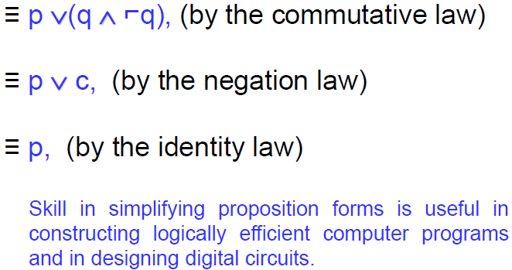

Slide 73

Exercise

Slide 74
Exercise
Prove that: ¬ (P ↔ Q) ≡ P ↔ ¬ Q
Solution:
≡ ¬ (P ↔ Q)
≡ ¬ [(P → Q) Λ (Q → P)] Bi-implication Law
≡ ¬ [(¬P ν Q) Λ (¬Q ν P)] Implication Law
≡ ¬ (¬P ν Q) ν ¬ (¬Q ν P)] De-Morgan Law
≡ (¬ (¬P) Λ ¬Q) ν (¬ (¬Q) Λ ¬P) De-Morgan Law
≡ (P Λ ¬Q) ν (Q Λ ¬P) Double Negation Law
≡ ((P Λ ¬Q) ν Q) Λ ((P Λ ¬Q) ν ¬P) Distributive Law
≡ ((Q ν ¬Q) Λ (Q ν P)) Λ ((¬P ν ¬Q) Λ (P ν ¬P)) Distributive Law
≡ ((T) Λ (Q ν P)) Λ ((¬P ν ¬Q) Λ (T)) Negation Law
≡ (Q ν P) Λ (¬P ν ¬Q) Universal Bound Law
≡ (¬ (¬Q) ν P) Λ (¬P ν ¬Q) Double Negation Law
≡ (¬ Q → P) Λ (P → ¬ Q) Implication Law
≡ P ↔ ¬ Q Bi-implication Law

Slide 75
Applications: Boolean Searches
Logical connectives are used extensively in searches of large collections of information.
Example: indexes of Web pages.
AND - used to match records that contain both of two search terms.
OR - used to match one or both of two search terms.
NOT - used to exclude a particular search term.
Read about: Web Page Searching

Slide 76
Applications: Logic Puzzles
Puzzles (important job interview question) that can be solved using logical reasoning
[Sm78] Smullyan: An island that has two kinds of inhabitants.
knights, who always tell the truth.
knaves, who always lie.
You encounter two people A and B.
What are A and B if:
A says “B is a knight” and
B says “The two of us are opposite types?”

Slide 77
Example 1:
p: A is a knight ¬p: A is a knave
q: B is a knight ¬q: B is a knave
Consider the possibility that A is a knight;
So, p is true. And he is telling truth.
So, q is true. So, A and B are the same type.
However, if B is a knight, then B ’s statement that A and B are of opposite types, the statement (p ∧¬q) ∨ (¬p ∧ q), would have to be true, which it is not, because A and B are both knights. Consequently, we can conclude that A is not a knight, that is, that p is false.

Slide 78
Example 1: Solution (cont..)
Consider the possibility that A is a knave,
everything a knave says is false; q is true, is a lie.
So, q is false. B is also a knave.
B ’s statement that A and B are opposite types is a lie, which is consistent with both A and B being knaves.
We can conclude that both A and B are knaves.

Slide 79
Example 2:
A father tells his two children, a boy and a girl, to play in their backyard without getting dirty.
However, while playing, both children get mud on their foreheads. When the children stop playing, the father says “At least one of you has a muddy forehead,” and then asks the children to answer “Yes” or “No” to the question: “Do you know whether you have a muddy forehead?”
The father asks this question twice. What will the children answer each time this question is asked, assuming that a child can see whether his or her sibling has a muddy forehead, but cannot see his or her own forehead?
Assume that both children are honest and that the children answer each question simultaneously.

Slide 80

Example 2:

Slide 81

Example 3:

Slide 82
The Foundations: Logic and Proofs
Chapter 1, Part II: Predicate Logic

Slide 83
Summary
Predicate Logic (First-Order Logic (FOL), Predicate Calculus)
The Language of Quantifiers
Logical Equivalences
Nested Quantifiers
Translation from Predicate Logic to English
Translation from English to Predicate Logic

Slide 84
Predicates and Quantifiers
Section 1.4

Slide 85
Section Summary
Predicates
Variables
Quantifiers
Universal Quantifier
Existential Quantifier
Negating Quantifiers
De Morgan’s Laws for Quantifiers
Translating English to Logic
Logic Programming (optional)

Slide 86
Propositional Logic Not Enough
If we have:
“All men are mortal.”
“Socrates is a man.”
Does it follow that “Socrates is mortal?”
Can’t be represented in propositional logic. Need a language that talks about objects, their properties, and their relations.
Later we’ll see how to draw inferences.

Slide 87
Introducing Predicate Logic
Predicate logic uses the following new features:
Variables: x, y, z
Predicates: P(x), M(x)
Quantifiers (to be covered in a few slides):
Propositional functions are a generalization of propositions.
They contain variables and a predicate, e.g., P(x)
Variables can be replaced by elements from their domain.

Slide 88
Propositional Functions
Propositional functions become propositions (and have truth values) when their variables are each replaced by a value from the domain (or bound by a quantifier, as we will see later).
The statement P(x) is said to be the value of the propositional function P at x.
For example, let P(x) denote “x > 0” and the domain be the integers. Then:
P(-3) is false.
P(0) is false.
P(3) is true.
Often the domain is denoted by U. So in this example U is the integers.

Slide 89
Examples of Propositional Functions
Let “x + y = z” be denoted by R(x, y, z) and U (for all three variables) be the integers. Find these truth values:
R(2,-1,5)
Solution: F
R(3,4,7)
Solution: T
R(x, 3, z)
Solution: Not a Proposition
Now let “x - y = z” be denoted by Q(x, y, z), with U as the integers. Find these truth values:
Q(2,-1,3)
Solution: T
Q(3,4,7)
Solution: F
Q(x, 3, z)
Solution: Not a Proposition

Slide 90
Compound Expressions
Connectives from propositional logic carry over to predicate logic.
If P(x) denotes “x > 0,” find these truth values:
P(3) ∨ P(-1) Solution: T
P(3) ∧ P(-1) Solution: F
P(3) → P(-1) Solution: F
P(3) → P(1) Solution: T
Expressions with variables are not propositions and therefore do not have truth values. For example,
P(3) ∧ P(y)
P(x) → P(y)
When used with quantifiers (to be introduced next), these expressions (propositional functions) become propositions.

Slide 91

Quantifiers
Charles Peirce (1839-1914)
We need quantifiers to express the meaning of English words including all and some:
“All men are Mortal.”
“Some cats do not have fur.”
The two most important quantifiers are:
Universal Quantifier, “For all,” symbol: ∀
Existential Quantifier, “There exists,” symbol: ∃
We write as in ∀x P(x) and ∃x P(x).
∀x P(x) asserts P(x) is true for every x in the domain.
∃x P(x) asserts P(x) is true for some x in the domain.
The quantifiers are said to bind the variable x in these expressions.

Slide 92

Quantifiers
Universal Quantifier, “For all,” symbol: ∀
Existential Quantifier, “There exists,” symbol: ∃

Slide 93
Universal Quantifier
∀x P(x) is read as “ For all x, P(x)” or “For every x, P(x)”
Examples:
If P(x) denotes “x > 0” and U is the integers, then ∀x P(x) is false.
If P(x) denotes “x > 0” and U is the positive integers, then ∀x P(x) is true.
If P(x) denotes “x is even” and U is the integers, then ∀ x P(x) is false.

Slide 94
Existential Quantifier
∃x P(x) is read as “For some x, P(x)”, or as “There is an x such that P(x),” or “For at least one x, P(x).”
Examples:
If P(x) denotes “x > 0” and U is the integers, then ∃x P(x) is true. It is also true if U is the positive integers.
If P(x) denotes “x < 0” and U is the positive integers, then ∃x P(x) is false.
If P(x) denotes “x is even” and U is the integers, then ∃x P(x) is true.

Slide 95
Uniqueness Quantifier (optional)
∃!x P(x) means that P(x) is true for one and only one x in the universe of discourse.
This is commonly expressed in English in the following equivalent ways:
“There is a unique x such that P(x).”
“There is one and only one x such that P(x)”
Examples:
If P(x) denotes “x + 1 = 0” and U is the integers, then ∃!x P(x) is true.
But if P(x) denotes “x > 0,” then ∃!x P(x) is false.
The uniqueness quantifier is not really needed as the restriction that there is a unique x such that P(x) can be expressed as:
∃x (P(x) ∧∀y (P(y) → y =x))

Slide 96
Thinking about Quantifiers
When the domain of discourse is finite, we can think of quantification as looping through the elements of the domain.
To evaluate ∀x P(x) loop through all x in the domain.
If at every step P(x) is true, then ∀x P(x) is true.
If at a step P(x) is false, then ∀x P(x) is false and the loop terminates.
To evaluate ∃x P(x) loop through all x in the domain.
If at some step, P(x) is true, then ∃x P(x) is true and the loop terminates.
If the loop ends without finding an x for which P(x) is true, then ∃x P(x) is false.
Even if the domains are infinite, we can still think of the quantifiers this fashion, but the loops will not terminate in some cases.

Slide 97
Properties of Quantifiers
The truth value of ∃x P(x) and ∀ x P(x) depend on both the propositional function P(x) and on the domain U.
Examples:
If U is the positive integers and P(x) is the statement “x < 2”, then ∃x P(x) is true, but ∀ x P(x) is false.
If U is the negative integers and P(x) is the statement “x < 2”, then both ∃x P(x) and ∀ x P(x) are true.
If U consists of 3, 4, and 5, and P(x) is the statement “x > 2”, then both ∃x P(x) and ∀ x P(x) are true. But if P(x) is the statement “x < 2”, then both ∃x P(x) and ∀ x P(x) are false.

Slide 98
Precedence of Quantifiers
The quantifiers ∀ and ∃ have higher precedence than all the logical operators.
For example, ∀x P(x) ∨ Q(x) means (∀x P(x))∨ Q(x)
∀x (P(x) ∨ Q(x)) means something different.
Unfortunately, often people write ∀x P(x) ∨ Q(x) when they mean ∀ x (P(x) ∨ Q(x)).

Slide 99
Translating from English to Logic
Example 1: Translate the following sentence into predicate logic: “Every student in this class has taken a course in Java.”
Solution:
First decide on the domain U.
Solution 1: If U is all students in this class, define a propositional function J(x) denoting “x has taken a course in Java” and translate as ∀x J(x).
Solution 2: But if U is all people, also define a propositional function S(x) denoting “x is a student in this class” and translate as ∀x (S(x)→ J(x)).
∀x (S(x) ∧ J(x)) is not correct. What does it mean?
Notes:
If we change the domain to consist of all people, we will need to express our statement as
“For every person x, if person x is a student in this class then x has studied java.”
If S(x) represents the statement that person x is in this class, we see that our statement can be expressed as ∀x(S(x) → J(x)). [Caution! Our statement cannot be expressed as ∀x(S(x) ∧ J(x)) because this statement says that all people are students in this class and have studied java!]

Slide 100
For example,
we may be interested in a wider group of people than only those in this class. If we change the domain to consist of all people, we will need to express our statement as
“For every person x, if person x is a student in this class then x has studied Java.”
If S(x) represents the statement that person x is in this class, we see that our statement can be expressed as ∀x(S(x) → J(x)).
[Caution! Our statement cannot be expressed as ∀x(S(x) ∧ J(x)) because this statement says that all people are students in this class and have studied
Java!]

Slide 101
Translating from English to Logic
Example 2: Translate the following sentence into predicate logic: “Some student in this class has taken a course in Java.”
Solution:
First decide on the domain U.
Solution 1: If U is all students in this class, translate as
∃x J(x)
Solution 1: But if U is all people, then translate as ∃x (S(x) ∧ J(x))
∃x (S(x)→ J(x)) is not correct. What does it mean?
Notes:
if we are interested in people other than those in this class, we look at the statement a little differently. Our statement can be expressed as
“There is a person x having the properties that x is a student in this class and x has Studied Java.”
In this case, the domain for the variable x consists of all people. We introduce S(x) to represent “x is a student in this class.” Our solution becomes ∃x(S(x) ∧ J(x)) [Caution! Our statement cannot be expressed as ∃x(S(x) → J(x)), which is true when there is someone not
in the class because, in that case, for such a person x, S(x) → J(x) becomes either F→T or F→F, both of which are true.]

Slide 102
if we are interested in people other than those in this class, we look at the statement a little differently. Our statement can be expressed as
“There is a person x having the properties that x is a student in this class and x has studied Java.”
In this case, the domain for the variable x consists of all people. We introduce S(x) to represent
“x is a student in this class.” Our solution becomes ∃x(S(x) ∧ J(x)) because the statement is that there is a person x who is a student in this class and who has studied Java.
[Caution! Our statement cannot be expressed as ∃x(S(x) → J(x)), which is true when there is someone not in the class because, in that case, for such a person x, S(x) → J(x) becomes either F→T or F→F, both of which are true.]

Slide 103


Returning to the Socrates Example
Introduce the propositional functions Man(x) denoting “x is a man” and Mortal(x) denoting “x is mortal.” Specify the domain as all people.
The two premises are:
The conclusion is:
Later we will show how to prove that the conclusion follows from the premises.

Slide 104
Equivalences in Predicate Logic
Statements involving predicates and quantifiers are logically equivalent if and only if they have the same truth value
for every predicate substituted into these statements and
for every domain of discourse used for the variables in the expressions.
The notation S ≡T indicates that S and T are logically equivalent.
Example: ∀x ¬¬S(x) ≡ ∀x S(x)

Slide 105
Thinking about Quantifiers as Conjunctions and Disjunctions
If the domain is finite, a universally quantified proposition is equivalent to a conjunction of propositions without quantifiers and an existentially quantified proposition is equivalent to a disjunction of propositions without quantifiers.
If U consists of the integers 1,2, and 3:
Even if the domains are infinite, you can still think of the quantifiers in this fashion, but the equivalent expressions without quantifiers will be infinitely long.

Slide 106
Negating Quantified Expressions
Consider ∀x J(x)
“Every student in your class has taken a course in Java.”
Here J(x) is “x has taken a course in Java” and
the domain is students in your class.
Negating the original statement gives “It is not the case that every student in your class has taken a course in Java.” This implies that “There is a student in your class who has not taken a course in Java.”
Symbolically ¬∀x J(x) and ∃x ¬J(x) are equivalent

Slide 107
Negating Quantified Expressions (continued)
Now Consider ∃ x J(x)
“There is a student in this class who has taken a course in Java.”
Where J(x) is “x has taken a course in Java.”
Negating the original statement gives “It is not the case that there is a student in this class who has taken Java.” This implies that “Every student in this class has not taken a course in Java”
Symbolically ¬∃ x J(x) and ∀ x ¬J(x) are equivalent

Slide 108



De Morgan’s Laws for Quantifiers
The rules for negating quantifiers are:
The reasoning in the table shows that:
These are important. You will use these.

Slide 109
Translation from English to Logic
Examples:
“Some student in this class has visited Mexico.”
Solution: Let M(x) denote “x has visited Mexico” and S(x) denote “x is a student in this class,” and U be all people.
∃x (S(x) ∧ M(x))
“Every student in this class has visited Canada or Mexico.”
Solution: Add C(x) denoting “x has visited Canada.”
and U be all people.
∀x (S(x)→ (M(x)∨C(x)))

Slide 110
Some Fun with Translating from English into Logical Expressions
U = {Nitwits, Blubbers, Oddments}
F(x): x is a Nitwit
S(x): x is a Blubber
T(x): x is a Oddment
Translate “Everything is a Nitwit”
Solution: ∀x F(x)

Slide 111
Translation (cont)
U = {Nitwits, Blubbers, Oddments}
F(x): x is a Nitwit
S(x): x is a Blubber
T(x): x is a Oddment
“Nothing is a Blubber.”
Solution: ¬∃x S(x) What is this equivalent to?
Solution: ∀x ¬ S(x)

Slide 112
Translation (cont)
U = {Nitwits, Blubbers, Oddments}
F(x): x is a Nitwit
S(x): x is a Blubber
T(x): x is a Oddment
“All Nitwits are Blubbers.”
Solution: ∀x (F(x)→ S(x))

Slide 113
Translation (cont)
U = {Nitwits, Blubbers, Oddments}
F(x): x is a Nitwit
S(x): x is a Blubber
T(x): x is a Oddment
“Some Nitwits are Oddments.”
Solution: ∃x (F(x) ∧ T(x))

Slide 114
Translation (cont)
U = {Nitwits, Blubbers, Oddments}
F(x): x is a Nitwit
S(x): x is a Blubber
T(x): x is a Oddment
“No Blubber is a Oddment.”
Solution: ¬∃x (S(x) ∧ T(x)) What is this equivalent to?
∀x ¬ (S(x) ∧ T(x))
∀x (¬S(x) ∨ ¬T(x))

Slide 115
Translation (cont)
U = {Nitwits, Blubbers, Oddments}
F(x): x is a Nitwit
S(x): x is a Blubber
T(x): x is a Oddment
“If any Nitwit is a Blubber then it is also a Oddment.”
Solution: ∀x ((F(x) ∧ S(x))→ T(x))

Slide 116

System Specification Example
Predicate logic is used for specifying properties that systems must satisfy.
For example, translate into predicate logic:
“Every mail message larger than one megabyte will be compressed.”
“If a user is active, at least one network link will be available.”
Decide on predicates and domains (left implicit here) for the variables:
Let L(m, y) be “Mail message m is larger than y megabytes.”
Let C(m) denote “Mail message m will be compressed.”
Let A(u) represent “User u is active.”
Let S(n, x) represent “Network link n is state x.
Now we have:

Slide 117
Lewis Carroll Example
The first two are called premises and the third is called the conclusion.
“All lions are fierce.”
“Some lions do not drink coffee.”
“Some fierce creatures do not drink coffee.”
Here is one way to translate these statements to predicate logic. Let P(x), Q(x), and R(x) be the propositional functions “x is a lion,” “x is fierce,” and “x drinks coffee,” respectively.
∀x (P(x)→ Q(x))
∃x (P(x) ∧ ¬R(x))
∃x (Q(x) ∧ ¬R(x))
Later we will see how to prove that the conclusion follows from the premises.

Slide 118
Nested Quantifiers
Section 1.5

Slide 119
Section Summary
Nested Quantifiers
Order of Quantifiers
Translating from Nested Quantifiers into English
Translating Mathematical Statements into Statements involving Nested Quantifiers.
Translated English Sentences into Logical Expressions.
Negating Nested Quantifiers.

Slide 120
Nested Quantifiers
Nested quantifiers are often necessary to express the meaning of sentences in English as well as important concepts in computer science and mathematics.
Example: “Every real number has an inverse” is
∀x ∃y(x + y = 0)
where the domains of x and y are the real numbers.
We can also think of nested propositional functions:
∀x ∃y(x + y = 0) can be viewed as ∀x Q(x) where Q(x) is ∃y P(x, y) where P(x, y) is (x + y = 0)

Slide 121
Thinking of Nested Quantification
Nested Loops
To see if ∀x∀yP (x,y) is true, loop through the values of x :
At each step, loop through the values for y.
If for some pair of x andy, P(x,y) is false, then ∀x ∀yP(x,y) is false and both the outer and inner loop terminate.
∀x ∀y P(x,y) is true if the outer loop ends after stepping through each x.
To see if ∀x ∃yP(x,y) is true, loop through the values of x:
At each step, loop through the values for y.
The inner loop ends when a pair x and y is found such that P(x, y) is true.
If no y is found such that P(x, y) is true the outer loop terminates as ∀x ∃yP(x,y) has been shown to be false.
∀x ∃y P(x,y) is true if the outer loop ends after stepping through each x.
If the domains of the variables are infinite, then this process can not actually be carried out.

Slide 122
Order of Quantifiers
Examples:
Let P(x,y) be the statement “x + y = y + x.” Assume that U is the real numbers. Then ∀x ∀yP(x,y) and∀y ∀xP(x,y) have the same truth value.
Let Q(x,y) be the statement “x + y = 0.” Assume that U is the real numbers. Then ∀x ∃yP(x,y) is true, but ∃y ∀xP(x,y) is false.

Slide 123
Questions on Order of Quantifiers
Example 1: Let U be the real numbers,
Define P(x,y) : x ∙ y = 0
What is the truth value of the following:
∀x∀yP(x,y)
Answer: False
∀x∃yP(x,y)
Answer: True
∃x∀y P(x,y)
Answer: True
∃x ∃ y P(x,y)
Answer: True

Slide 124
Questions on Order of Quantifiers
Example 2: Let U be the real numbers,
Define P(x,y) : x / y = 1
What is the truth value of the following:
∀x∀yP(x,y)
Answer: False
∀x∃yP(x,y)
Answer: True
∃x∀y P(x,y)
Answer: False
∃x ∃ y P(x,y)
Answer: True

Slide 125






Quantifications of Two Variables
Statement | When True? | When False
 | P(x,y) is true for every pair x,y. | There is a pair x, y for which P(x,y) is false.
 | For every x there is a y for which P(x,y) is true. | There is an x such that P(x,y) is false for every y.
 | There is an x for which P(x,y) is true for every y. | For every x there is a y for which P(x,y) is false.
 | There is a pair x, y for which P(x,y) is true. | P(x,y) is false for every pair x,y

Slide 126
Translating Nested Quantifiers into English
Example 1: Translate the statement
∀x (C(x )∨ ∃y (C(y ) ∧ F(x, y)))
where C(x) is “x has a computer,” and F(x,y) is “x and y are friends,” and the domain for both x and y consists of all students in your school.
Solution: Every student in your school has a computer or has a friend who has a computer.

Slide 127
Translating Mathematical Statements into Predicate Logic
Example : Translate “The sum of two positive integers is always positive” into a logical expression.
Solution:
Rewrite the statement to make the implied quantifiers and domains explicit:
“For every two integers, if these integers are both positive, then the sum of these integers is positive.”
Introduce the variables x and y, and specify the domain, to obtain:
“For all positive integers x and y, x + y is positive.”
The result is:
∀x ∀ y ((x > 0)∧ (y > 0)→ (x + y > 0))
where the domain of both variables consists of all integers

Slide 128
Translating English into Logical Expressions Example
Example: Use quantifiers to express the statement “There is a woman who has taken a flight on every airline in the world.”
Solution:
Let P(w,f) be “w has taken f ” and Q(f,a) be “f is a flight on a .”
The domain of w is all women, the domain of f is all flights, and the domain of a is all airlines.
Then the statement can be expressed as:
∃w ∃f ∀a (P(w,f ) ∧ Q(f,a))

Slide 129
Questions on Translation from English
Choose the obvious predicates and express in predicate logic.
Example 1: “Brothers are siblings.”
Solution: ∀x ∀y (B(x,y) → S(x,y))
Example 2: “Siblinghood is symmetric.”
Solution: ∀x ∀y (S(x,y) → S(y,x))
Example 3: “Everybody loves somebody.”
Solution: ∀x ∃y L(x,y)
Example 4: “There is someone who is loved by everyone.”
Solution: ∃y ∀x L(x,y)
Example 5: “There is someone who loves someone.”
Solution: ∃x ∃y L(x,y)
Example 6: “Everyone loves himself”
Solution: ∀x L(x,x)

Slide 130
Negating Nested Quantifiers
Example 1: Recall the logical expression developed three slides back:
∃w ∀a ∃f (P(w,f ) ∧ Q(f,a))
Part 1: Use quantifiers to express the statement that “There does not exist a woman who has taken a flight on every airline in the world.”
Solution: ¬∃w ∀a ∃f (P(w,f ) ∧ Q(f,a))
Part 2: Now use De Morgan’s Laws to move the negation as far inwards as possible.
Solution:
¬∃w ∀a ∃f (P(w,f ) ∧ Q(f,a))
∀w ¬ ∀a ∃f (P(w,f ) ∧ Q(f,a)) by De Morgan’s for ∃
∀w ∃ a ¬ ∃f (P(w,f ) ∧ Q(f,a)) by De Morgan’s for ∀
∀w ∃ a ∀f ¬ (P(w,f ) ∧ Q(f,a)) by De Morgan’s for ∃
∀w ∃ a ∀f (¬ P(w,f ) ∨ ¬ Q(f,a)) by De Morgan’s for ∧.
Part 3: Can you translate the result back into English?
Solution:
“For every woman there is an airline such that for all flights, this woman has not taken that flight or that flight is not on this airline”

Slide 131
Some Questions about Quantifiers
Can you switch the order of quantifiers?
Is this a valid equivalence?
Solution: Yes! The left and the right side will always have the same truth value. The order in which x and y are picked does not matter.
Is this a valid equivalence?
Solution: No! The left and the right side may have different truth values for some propositional functions for P. Try “x + y = 0” for P(x,y) with U being the integers. The order in which the values of x and y are picked does matter.
Can you distribute quantifiers over logical connectives?
Is this a valid equivalence?
Solution: Yes! The left and the right side will always have the same truth value no matter what propositional functions are denoted by P(x) and Q(x).
Is this a valid equivalence?
Solution: No! The left and the right side may have different truth values. Pick “x is a fish” for P(x) and “x has scales” for Q(x) with the domain of discourse being all animals. Then the left side is false, because there are some fish that do not have scales. But the right side is true since not all animals are fish.

Slide 132
The Foundations: Logic and Proofs
Chapter 1, Part III: Proofs

Slide 133
Summary
Valid Arguments and Rules of Inference
Proof Methods
Proof Strategies

Slide 134
Rules of Inference
Section 1.6

Slide 135
Section Summary
Valid Arguments
Inference Rules for Propositional Logic
Using Rules of Inference to Build Arguments
Rules of Inference for Quantified Statements
Building Arguments for Quantified Statements

Slide 136
Revisiting the Socrates Example
We have the two premises:
“All men are mortal.”
“Socrates is a man.”
And the conclusion:
“Socrates is mortal.”
How do we get the conclusion from the premises?

Slide 137

The Argument
We can express the premises (above the line) and the conclusion (below the line) in predicate logic as an argument:
We will see shortly that this is a valid argument.

Slide 138
Valid Arguments
We will show how to construct valid arguments in two stages; first for propositional logic and then for predicate logic. The rules of inference are the essential building block in the construction of valid arguments.
Propositional Logic
Inference Rules
Predicate Logic
Inference rules for propositional logic plus additional inference rules to handle variables and quantifiers.

Slide 139
Valid Arguments (Propositional Logic)
“If you have a current password, then you can log onto the network.”
“You have a current password.”
Therefore, “You can log onto the network.”
Sequence of propositions (argument) is valid; the conclusion must be true when both premise are true.

Slide 140
Argument Form
p: “You have a current password”
q: “You can log onto the network.”
the argument has the form
p→q
p
∴q
the statement ((p → q) ∧ p) → q is a tautology

Slide 141
Argument Form
p: ““You have access to the network”
q: “You can change your grade”
the argument has the form
“If you have access to the network, then you can change your grade.”
“You have access to the network.”
∴ “You can change your grade.”
The argument is valid, but if premise is false, we cannot conclude that the conclusion is true.

Slide 142
Arguments in Propositional Logic
A argument in propositional logic is a sequence of propositions. All but the final proposition are called premises. The last statement is the conclusion.
The argument is valid if the premises imply the conclusion. An argument form is an argument that is valid no matter what propositions are substituted into its propositional variables.
If the premises are p₁ ,p₂, …,p_{n} and the conclusion is q then
(p₁ ∧ p₂ ∧ … ∧ p_{n} ) → q is a tautology.
Inference rules are all argument simple argument forms that will be used to construct more complex argument forms.

Slide 143


Slide 144



Slide 145

Rules of Inference for Propositional Logic: Modus Ponendo Ponens
Latin for “the way that affirms by affirming”
Implication elimination
Abbreviated to MP or modus ponens
whenever p → q is true
and p is true,
q must also be true.
p | q | p → q
T | T | T
T | F | F
F | T | T
F | F | T

Slide 146

Modus Ponens
Corresponding Tautology:
(p ∧ (p →q)) → q
Example:
Let p be “It is snowing.”
Let q be “I will study discrete math.”
“If it is snowing, then I will study discrete math.”
“It is snowing.”
“Therefore , I will study discrete math.”

Slide 147
Modus Ponens
State which rule of inference is the basis of the following argument:
“If it snows today, then we will go skiing”. “It is snowing today”, “therefore we will go skiing”.
Let p be the proposition “It is snowing today” and q the proposition “We will go skiing” Then this argument is of the form
p 🡪 q
p
∴q
This is an argument that uses the Modus Ponens rule.

Slide 148

Modus Tollendo Tollens
Latin for "the way that denies by denying"
Denying the consequent
Abbreviated to modus tollens
in every instance in which
p → q is true and q is false,
p must also be false.
p | q | p → q
T | T | T
T | F | F
F | T | T
F | F | T

Slide 149

Modus Tollens
Corresponding Tautology:
(¬p∧(p →q))→¬q
Example:
Let p be “it is snowing.”
Let q be “I will study discrete math.”
“If it is snowing, then I will study discrete math.”
“I will not study discrete math.”
“Therefore , it is not snowing.”

Slide 150

Hypothetical Syllogism
Corresponding Tautology:
((p →q) ∧ (q→r))→(p→ r)
Example:
Let p be “it snows.”
Let q be “I will study discrete math.”
Let r be “I will get an A.”
“If it snows, then I will study discrete math.”
“If I study discrete math, I will get an A.”
“Therefore , If it snows, I will get an A.”

Slide 151
Hypothetical Syllogism
State which rule of inference is used in the argument:
If it rains today, then we will not have a barbecue today. If we do not have a barbecue today, then we will have a barbecue tomorrow. Therefore, if it rains today, then we will have a barbecue tomorrow.
p→q
q→r
∴p→r
Hence, this argument is a hypothetical syllogism.

Slide 152

Disjunctive Syllogism
Corresponding Tautology:
(¬p∧(p ∨q))→q
Example:
Let p be “I will study discrete math.”
Let q be “I will study English literature.”
“I will study discrete math or I will study English literature.”
“I will not study discrete math.”
“Therefore , I will study English literature.”

Slide 153

Addition
Corresponding Tautology:
p →(p ∨q)
Example:
Let p be “I will study discrete math.”
Let q be “I will visit Las Vegas.”
“I will study discrete math.”
“Therefore, I will study discrete math or I will visit
Las Vegas.”

Slide 154
Addition Rule
State which rule of inference is the basis of the following argument:
“It is below freezing now. Therefore, it is either below freezing or raining now.”
Let p be the proposition “It is below freezing now” and q the proposition “It is raining now.” Then this argument is of the form
p
∴p∨q
This is an argument that uses the addition rule.

Slide 155

Simplification
Corresponding Tautology:
(p∧q) →p
Example:
Let p be “I will study discrete math.”
Let q be “I will study English literature.”
“I will study discrete math and English literature”
“Therefore, I will study discrete math.”

Slide 156
Simplification Rule
State which rule of inference is the basis of the following argument:
“It is below freezing and raining now. Therefore, it is below freezing now.”
Let p be the proposition “It is below freezing now,” and let q be the proposition “It is raining now.” This argument is of the form
p∧q
∴p
This argument uses the simplification rule.

Slide 157

Conjunction
Corresponding Tautology:
((p) ∧ (q)) →(p ∧ q)
Example:
Let p be “I will study discrete math.”
Let q be “I will study English literature.”
“I will study discrete math.”
“I will study English literature.”
“Therefore, I will study discrete math and I will study English literature.”

Slide 158

Resolution
Resolution plays an important role in AI and is used in Prolog.
Corresponding Tautology:
((¬p ∨ r ) ∧ (p ∨ q)) →(q ∨ r)
Example:
Let p be “I will study discrete math.”
Let r be “I will study English literature.”
Let q be “I will study databases.”
“I will not study discrete math or I will study English literature.”
“I will study discrete math or I will study databases.”
“Therefore, I will study databases or I will English literature.”

Slide 159

Using the Rules of Inference to Build Valid Arguments
A valid argument is a sequence of statements. Each statement is either a premise or follows from previous statements by rules of inference. The last statement is called conclusion.
A valid argument takes the following form:
S₁
S₂
.
.
.
S_{n}
C

Slide 160
Fallacies
Arguments are based on tautologies.
Fallacies are based on contingencies.
The proposition ((p → q) ∧q) → p is not a tautology, because it is false when p is false and q is true.
This type of incorrect reasoning is called the fallacy of affirming the conclusion.
Example:
If you do every problem in this book, then you will learn discrete mathematics. You learned discrete mathematics. Therefore, you did every problem in this book.

Slide 161
Fallacy of denying the hypothesis.
The proposition ((p → q)∧￢p)→￢q is not a tautology, because it is false when p is false and q is true.
Is it correct to assume that you did not learn discrete mathematics if you did not do every problem in the book, assuming that if you do every problem in this book, then you will learn discrete mathematics?
It is possible that you learned discrete mathematics even if you did not do every problem in this book. This incorrect argument is of the form p → q and ￢p imply ￢q, which is an example of the fallacy of denying the hypothesis.

Slide 162


Slide 163


Slide 164


Slide 165


Slide 166


Slide 167


Slide 168


Slide 169


Slide 170

EXAMPLE #2

Slide 171


Slide 172


Slide 173


Slide 174


Valid Arguments
Example 3: From the single proposition
Show that q is a conclusion.
Solution:

Slide 175

Valid Arguments (Predicate Logic)

Slide 176
Universal Instantiation
Universal instantiation is the rule of inference used to conclude that P(c) is true, where c is a particular member of the domain, given the premise ∀x P(x).
•Universal instantiation is used when we conclude from the statement “All women are wise” that “Lisa is wise,” where Lisa is a member of the domain of all women.

Slide 177
Universal Generalization
Universal generalization is the rule of inference that states that ∀xP (x) is true, given the premise that P(c)is true for all elements c in the domain.
•Universal generalization is used when we show that ∀x P(x) is true by taking an arbitrary element c from the domain and showing that P(c) is true.
•Universal generalization is used implicitly in many proofs in mathematics and is seldom mentioned explicitly. However, the error of adding unwarranted assumptions about the arbitrary element c when universal generalization is used is all too common in incorrect reasoning.

Slide 178
Existential Instantiation
Existential instantiation is the rule that allows us to conclude that there is an element c in the domain for which P(c) is true if we know that ∃x P(x) is true.
We cannot select an arbitrary value of c here, but rather it must be a c for which P(c) is true.
Usually we have no knowledge of what c is, only that it exists. Because it exists, we may give it a name (c) and continue our argument.

Slide 179
Existential Generalization
Existential generalization is the rule of inference that is used to conclude that ∃x P(x) is true when a particular element c with P(c) true is known.
That is, if we know one element c in the domain for which P(c) is true, then we know that ∃x P(x) is true.

Slide 180
Basic Structures: Sets and Functions
Chapter 2

Slide 181
Sets
Section 2.1

Slide 182
Section Summary
Definition of sets
Describing Sets
Roster Method
Set-Builder Notation
Some Important Sets in Mathematics
Empty Set and Universal Set
Subsets and Set Equality
Cardinality of Sets
Tuples
Cartesian Product

Slide 183
Introduction
Sets are one of the basic building blocks for the types of objects considered in discrete mathematics.
Important for counting.
Programming languages have set operations.
Set theory is an important branch of mathematics.
Many different systems of axioms have been used to develop set theory.
Here we are not concerned with a formal set of axioms for set theory. Instead, we will use what is called naïve set theory.

Slide 184
Sets
A set is an unordered collection of objects.
the students in this class
the chairs in this room
The objects in a set are called the elements, or members of the set. A set is said to contain its elements.
The notation a ∈ A denotes that a is an element of the set A.
If a is not a member of A, write a ∉ A

Slide 185
Describing a Set: Roster Method
S = {a,b,c,d}
Order not important
S = {a,b,c,d} = {b,c,a,d}
Each distinct object is either a member or not; listing more than once does not change the set.
S = {a,b,c,d} = {a,b,c,b,c,d}
Elipses (…) may be used to describe a set without listing all of the members when the pattern is clear.
S = {a,b,c,d, ……,z }

Slide 186
Roster Method
Set of all vowels in the English alphabet:
V = {a,e,i,o,u}
Set of all odd positive integers less than 10:
O = {1,3,5,7,9}
Set of all positive integers less than 100:
S = {1,2,3,……..,99}
Set of all integers less than 0:
S = {…., -3,-2,-1}

Slide 187
Some Important Sets
N = natural numbers = {0,1,2,3….}
Z = integers = {…,-3,-2,-1,0,1,2,3,…}
Z⁺ = positive integers = {1,2,3,…..}
R = set of real numbers
R⁺ = set of positive real numbers
C = set of complex numbers.
Q = set of rational numbers

Slide 188
Set-Builder Notation
Specify the property or properties that all members must satisfy:
S = {x | x is a positive integer less than 100}
O = {x | x is an odd positive integer less than 10}
O = {x ∈ Z⁺ | x is odd and x < 10}
A predicate may be used:
S = {x | P(x)}
Example: S = {x | Prime(x)}
Positive rational numbers:
Q⁺ = {x ∈ R | x = p/q, for some positive integers p,q}

Slide 189

Universal Set and Empty Set
The universal set U is the set containing everything currently under consideration.
Sometimes implicit
Sometimes explicitly stated.
Contents depend on the context.
The empty set is the set with no
elements. Symbolized ∅, but
{} also used.
Venn Diagram
U
a e i
o u
V
John Venn (1834-1923)
Cambridge, UK

Slide 190
Some things to remember
Sets can be elements of sets.
{{1,2,3},a, {b,c}}
{N,Z,Q,R}
The empty set is different from a set containing the empty set.
∅ ≠ { ∅ }

Slide 191

Set Equality
Definition: Two sets are equal if and only if they have the same elements.
Therefore if A and B are sets, then A and B are equal if and only if .
We write A = B if A and B are equal sets.
{1,3,5} = {3, 5, 1}
{1,5,5,5,3,3,1} = {1,3,5}

Slide 192

Subsets
Definition: The set A is a subset of B, if and only if every element of A is also an element of B.
The notation A ⊆ B is used to indicate that A is a subset of the set B.
A ⊆ B holds if and only if is true.
Because a ∈ ∅ is always false, ∅ ⊆ S ,for every set S.
Because a ∈ S → a ∈ S, S ⊆ S, for every set S.

Slide 193
Showing a Set is or is not a Subset of Another Set
Showing that A is a Subset of B: To show that A ⊆ B, show that if x belongs to A, then x also belongs to B.
Showing that A is not a Subset of B: To show that A is not a subset of B, A ⊈ B, find an element x ∈ A with x ∉ B. (Such an x is a counterexample to the claim that x ∈ A implies x ∈ B.)
Examples:
The set of all computer science majors at your school is a subset of all students at your school.
The set of integers with squares less than 100 is not a subset of the set of nonnegative integers.

Slide 194
Another look at Equality of Sets
Recall that two sets A and B are equal, denoted by A = B, iff
Using logical equivalences we have that A = B iff
This is equivalent to
A ⊆ B and B ⊆ A

Slide 195
Proper Subsets
Definition: If A ⊆ B, but A ≠B, then we say A is a proper subset of B, denoted by A ⊂ B. If A ⊂ B, then
is true.
Venn Diagram
U
B
A

Slide 196
Set Cardinality
Definition: If there are exactly n distinct elements in S where n is a nonnegative integer, we say that S is finite. Otherwise it is infinite.
Definition: The cardinality of a finite set A, denoted by |A|, is the number of (distinct) elements of A.
Examples:
|ø| = 0
Let S be the letters of the English alphabet. Then |S| = 26
|{1,2,3}| = 3
|{ø}| = 1
The set of integers is infinite.

Slide 197
Power Sets
Definition: The set of all subsets of a set A, denoted P(A), is called the power set of A.
Example: If A = {a,b} then
P(A) = {ø, {a},{b},{a,b}}
If a set has n elements, then the cardinality of the power set is 2ⁿ. (In Chapters 5 and 6, we will discuss different ways to show this.)

Slide 198
Tuples
The ordered n-tuple (a₁,a₂,…..,a_{n}) is the ordered collection that has a₁ as its first element and a₂ as its second element and so on until a_{n} as its last element.
Two n-tuples are equal if and only if their corresponding elements are equal.
2-tuples are called ordered pairs.
The ordered pairs (a,b) and (c,d) are equal if and only if a = c and b = d.

Slide 199

Cartesian Product
René Descartes (1596-1650)
Definition: The Cartesian Product of two sets A and B, denoted by A × B is the set of ordered pairs (a,b) where a ∈ A and b ∈ B .
Example:
A = {a,b} B = {1,2,3}
A × B = {(a,1),(a,2),(a,3), (b,1),(b,2),(b,3)}
Definition: A subset R of the Cartesian product A × B is called a relation from the set A to the set B. (Relations will be covered in depth in Chapter 9. )

Slide 200

Cartesian Product
Definition: The cartesian products of the sets A₁,A₂,……,A_{n}, denoted by A₁ × A₂ × …… × A_{n} , is the set of ordered n-tuples (a₁,a₂,……,a_{n}) where a_{i} belongs to A_{i} for i = 1, … n.
Example: What is A × B × C where A = {0,1}, B = {1,2} and C = {0,1,2}
Solution: A × B × C = {(0,1,0), (0,1,1), (0,1,2),(0,2,0), (0,2,1), (0,2,2),(1,1,0), (1,1,1), (1,1,2), (1,2,0), (1,2,1), (1,1,2)}

Slide 201

Truth Sets of Quantifiers
Given a predicate P and a domain D, we define the truth set of P to be the set of elements in D for which P(x) is true. The truth set of P(x) is denoted by
Example: The truth set of P(x) where the domain is the integers and P(x) is “|x| = 1” is the set {-1,1}

Slide 202
Set Operations
Section 2.2

Slide 203
Section Summary
Set Operations
Union
Intersection
Complementation
Difference
More on Set Cardinality
Set Identities
Proving Identities
Membership Tables

Slide 204
Boolean Algebra
Propositional calculus and set theory are both instances of an algebraic system called a Boolean Algebra. This is discussed in Chapter 12.
The operators in set theory are analogous to the corresponding operator in propositional calculus.
As always there must be a universal set U. All sets are assumed to be subsets of U.

Slide 205

Union
Definition: Let A and B be sets. The union of the sets A and B, denoted by A ∪ B, is the set:
Example: What is {1,2,3} ∪ {3, 4, 5}?
Solution: {1,2,3,4,5}
Venn Diagram for A ∪ B
U
A
B

Slide 206

Intersection
Definition: The intersection of sets A and B, denoted by A ∩ B, is
Note if the intersection is empty, then A and B are said to be disjoint.
Example: What is? {1,2,3} ∩ {3,4,5} ?
Solution: {3}
Example:What is?
{1,2,3} ∩ {4,5,6} ?
Solution: ∅
Venn Diagram for A ∩B
U
A
B

Slide 207
Complement
Definition: If A is a set, then the complement of the A (with respect to U), denoted by Ā is the set U - A
Ā = {x ∈ U | x ∉ A}
(The complement of A is sometimes denoted by A^{c} .)
Example: If U is the positive integers less than 100, what is the complement of {x | x > 70}
Solution: {x | x ≤ 70}
Venn Diagram for Complement
U
A
Ā

Slide 208
Difference
Definition: Let A and B be sets. The difference of A and B, denoted by A – B, is the set containing the elements of A that are not in B. The difference of A and B is also called the complement of B with respect to A.
A – B = {x | x ∈ A ∧ x ∉ B} = A ∩B
Venn Diagram for A − B
U
A
B

Slide 209
The Cardinality of the Union of Two Sets
Inclusion-Exclusion
|A ∪ B| = |A| + | B| - |A ∩ B|
Example: Let A be the math majors in your class and B be the CS majors. To count the number of students who are either math majors or CS majors, add the number of math majors and the number of CS majors, and subtract the number of joint CS/math majors.
We will return to this principle in Chapter 6 and Chapter 8 where we will derive a formula for the cardinality of the union of n sets, where n is a positive integer.
U
A
B
Venn Diagram for A, B, A ∩ B, A ∪ B

Slide 210

Inclusion-Exclusion Principle
Question: There are 100 students in a class, 47 are learning English and 23 are learning French Language whereas 5 learning both languages. How many learning either and how many learning neither? Draw Venn diagram.
Solution:
Total number of students, n(µ) = 100
Number of English language students, n(E) = 47
Number of French language students, n(F) = 23
Number of students who learning both, n(E∩F) = 5
Number of students who learning either of them,
n(EᴜF) = n(E) + n(F) – n(E∩F) = 47+23-5 = 65
Number of students who learning neither = n(µ) – n(EᴜF) = 100 – 65 = 35.

Slide 211
Review Questions
Example: U = {0,1,2,3,4,5,6,7,8,9,10} A = {1,2,3,4,5}, B ={4,5,6,7,8}
A ∪ B
Solution: {1,2,3,4,5,6,7,8}
A ∩ B
Solution: {4,5}
Ā
Solution: {0,6,7,8,9,10}
Solution: {0,1,2,3,9,10}
A – B
Solution: {1,2,3}
B – A
Solution: {6,7,8}

Slide 212


Symmetric Difference (optional)
Definition: The symmetric difference of A and B, denoted by is the set
Example:
U = {0,1,2,3,4,5,6,7,8,9,10}
A = {1,2,3,4,5} B ={4,5,6,7,8}
What is:
Solution: {1,2,3,6,7,8}
U
A
B
Venn Diagram

Slide 213







Set Identities
Identity laws
Domination laws
Idempotent laws
Complementation law
Continued on next slide 🡪

Slide 214


Set Identities
Commutative laws
Associative laws
Distributive laws
Continued on next slide 🡪

Slide 215






Set Identities
De Morgan’s laws
Absorption laws
Complement laws

Slide 216
Proving Set Identities
Different ways to prove set identities:
Prove that each set (side of the identity) is a subset of the other.
Use set builder notation and propositional logic.
Membership Tables: Verify that elements in the same combination of sets always either belong or do not belong to the same side of the identity. Use 1 to indicate it is in the set and a 0 to indicate that it is not.

Slide 217

Proving Set Identities Example:

Slide 218
Proving Set Identities
Prove the following set operations: P − (Q ∩ R) = (P − Q) U (P − R).
Solution:
L.H.S = P − (Q ∩ R)
= P ∩ (Q ∩ R )^{c} A – B = A ∩ B^{c}
= P ∩ (Q^{c} U R^{c}) De-Morgan Law
= (P ∩ Q^{c}) U (P ∩ R^{c}) Distributive Law
= (P − Q) U (P – R) A – B = A ∩ B^{c}
= R.H.S

Slide 219


Proof of Second De Morgan Law
Example: Prove that
Solution: We prove this identity by showing that:
1) and
2)
Continued on next slide 🡪

Slide 220

Proof of Second De Morgan Law
These steps show that:
Continued on next slide 🡪

Slide 221

Proof of Second De Morgan Law
These steps show that:

Slide 222

Set-Builder Notation: Second De Morgan Law

Slide 223





Membership Table
Example:
Construct a membership table to show that the distributive law holds.
Solution:
A | B | C
1 | 1 | 1 | 1 | 1 | 1 | 1 | 1
1 | 1 | 0 | 0 | 1 | 1 | 1 | 1
1 | 0 | 1 | 0 | 1 | 1 | 1 | 1
1 | 0 | 0 | 0 | 1 | 1 | 1 | 1
0 | 1 | 1 | 1 | 1 | 1 | 1 | 1
0 | 1 | 0 | 0 | 0 | 1 | 0 | 0
0 | 0 | 1 | 0 | 0 | 0 | 1 | 0
0 | 0 | 0 | 0 | 0 | 0 | 0 | 0

Slide 224
Characteristic Vectors: Sets as Bit-Vectors
Sets stored in an unordered fashion in memory.
Union/Intersection etc. are computationally expensive.
When |U| is small compared to computer memory, then we can do set operations efficiently.
Impose any fixed ordering on elements of U.
U = {DM, Cal, Chem, Bio, Phy, Pro} (in order)
Sets (subsets of U) are represented by bit-string of length 6.
Each bit signifies whether the corresponding element is in the set Called bit-vector representation of sets or characteristic vector of a set.

Slide 225


Characteristic Vectors: Sets as Bit-Vectors

Slide 226


Characteristic Vectors: Sets as Bit-Vectors

Slide 227


Sets operations using bit-strings

Slide 228

Sets operations using bit-strings

Slide 229

Sets operations using bit-strings

Slide 230
Sets as bit-vectors: Summary
Sets can be represented as bit vectors, when universal set is ‘small’
Also called characteristic vectors of sets
Order of U is critical.
Sets operations can be performed using bit-wise operators of programming language.
More suitable for computer implementations.
Only feasible when U is small.

Slide 231

Multiset

Slide 232

Multisets: Terminology

Slide 233

Multisets: Multiplicity

Slide 234

Multisets: Union

Slide 235

Multisets: Intersection

Slide 236

Multisets: Sum

Slide 237

Multisets: Difference

Slide 238

The Set-of-Words Vector Model for Text Representation

Slide 239

The Bag of words Vector Model for Text Representation

Slide 240
Functions
Section 2.3

Slide 241
Section Summary
Definition of a Function.
Domain, Codomain
Image, Pre image
Injection, Surjection, Bijection
Inverse Function
Function Composition
Graphing Functions
Floor, Ceiling, Factorial

Slide 242
Functions
Definition: Let A and B be nonempty sets. A function f from A to B, denoted f: A → B is an assignment of each element of A to exactly one element of B. We write f(a) = b if b is the unique element of B assigned by the function f to the element a of A.
Functions are sometimes
called mappings or
transformations.
Students
Grades
A
Carlota Rodriguez
B
Sandeep Patel
C
Jalen Williams
D
F
Kathy Scott

Slide 243

Functions
Definition: Let A and B be nonempty sets. A function f from A to B, denoted f: A → B is an assignment of each element of A to exactly one element of B. We write f(a) = b if b is the unique element of B assigned by the function f to the element a of A.

Slide 244
Functions
A function f: A → B can also be defined as a subset of A×B (a relation). This subset is restricted to be a relation where no two elements of the relation have the same first element.
Specifically, a function f from A to B contains one, and only one ordered pair (a, b) for every element a∈ A.
and

Slide 245

Functions
Given a function f: A → B:
We say f maps A to B or
f is a mapping from A to B.
A is called the domain of f.
B is called the codomain of f.
If f(a) = b,
then b is called the image of a under f.
a is called the preimage of b.
The range of f is the set of all images of points in A under f. We denote it by f(A).
Two functions are equal when they have the same domain, the same codomain and map each element of the domain to the same element of the codomain.

Slide 246
Equal Functions
Two functions are equal when they
have the same domain,
have the same codomain,
map each element of their common domain to the same element in their common codomain.
If we change either the domain or the codomain of a function, then we obtain a different function.
If we change the mapping of elements, then we also obtain a different function.

Slide 247
Representing Functions
Functions may be specified in different ways:
An explicit statement of the assignment.
Students and grades example.
A formula.
f(x) = x + 1
A computer program.
A Java program that when given an integer n, produces the nth Fibonacci Number (covered in the next section and also inChapter 5).

Slide 248

Activity Time
What are the domain, codomain, and range of the following function

Slide 249
Solution
Let G be the function that assigns a grade to a student in our discrete mathematics class.
Note that G(Adams) = A, for instance.
The domain of G is the set {Adams, Chou, Goodfriend, Rodriguez, Stevens},
The codomain is the set {A,B,C,D,F}.
The range of G is the set {A,B,C, F},

Slide 250
Questions
z
A
B
f(a) = ?
The image of d is ?
z
a
x
The domain of f is ?
A
b
y
The codomain of f is ?
B
c
d
z
The preimage of y is ?
b
f(A) = ?
The preimage(s) of z is (are) ?
{a,c,d}

Slide 251


Question on Functions and Sets
If and S is a subset of A, then
A
B
f {a,b,c,} is ?
{y,z}
a
x
f {c,d} is ?
b
{z}
y
c
d
z

Slide 252

Injections
Definition: A function f is said to be one-to-one , or injective, if and only if f(a) = f(b) implies that a = b for all a and b in the domain of f. A function is said to be an injection if it is one-to-one.
A
B
a
x
v
b
y
c
z
d
w

Slide 253



Surjections
Definition: A function f from A to B is called onto or surjective, if and only if for every element there is an element with . A function f is called a surjection if it is onto.
A
B
a
x
b
y
c
z
d

Slide 254
Bijections
Definition: A function f is a one-to-one correspondence, or a bijection, if it is both one-to-one and onto (surjective and injective).
A
B
a
x
b
y
c
d
z
w

Slide 255


Slide 256
real-valued
A function is called real-valued if its codomain is the set of real numbers.
Let f1 and f2 be functions from A to R.
Then f1 + f2 and f1f2 are also functions from A to R defined for all x ∈ A by
(f1 + f2)(x) = f1(x) + f2(x),
(f1f2)(x) = f1(x)f2(x).

Slide 257

real-valued Functions

Slide 258

Showing that f is one-to-one or onto

Slide 259
Showing that f is one-to-one or onto
Example 1: Let f be the function from {a,b,c,d} to {1,2,3} defined by f(a) = 3, f(b) = 2, f(c) = 1, and f(d) = 3. Is f an onto function?
Solution:
Yes, f is onto since all three elements of the codomain are images of elements in the domain. If the codomain were changed to {1,2,3,4}, f would not be onto.

Slide 260

Example 2:
Determine whether the function f (x) = x² from the set of integers to the set of integers is one-to-one.
Solution:

Slide 261
Increasing/ decreasing functions
A function f whose domain and codomain are subsets of the set of real numbers is called increasing if f (x) ≤ f (y), and strictly increasing if f(x) < f(y), whenever x < y and x and y are in the domain of f.
Similarly, f is called decreasing if f (x) ≥ f (y), and strictly decreasing if f(x) > f(y), whenever x < y and x and y are in the domain of f.

Slide 262
Increasing/ decreasing functions
A function f is
increasing if ∀x∀y(x < y → f (x) ≤ f (y)),
strictly increasing if ∀x∀y(x < y → f (x) < f (y)),
decreasing if ∀x∀y(x < y → f (x) ≥ f (y)),
strictly decreasing if ∀x∀y(x < y → f (x) > f (y)),
where the universe of discourse is the domain of f.

Slide 263


Increasing/ decreasing functions

Slide 264
Relationship with one-to-one
A function that is either strictly increasing or strictly decreasing must be one-to-one.
Why?
One-to-one function: A function is one-to-one if and only if f(x) ≠ f(y), whenever x ≠ y.
A function that is increasing, but not strictly increasing, or decreasing, but not strictly decreasing, is not one-to-one.

Slide 265
The identity function
Let A be a set. The identity function on A is the function i A : A → A, where
i A(x) = x
for all x ∈ A.
The function i A is one-to-one and onto, so it is a bijection.

Slide 266
The identity function
Example:
Let A ={1, 2, 3}
Solution:
i A(1) = 1
i A(2) = 2
i A(3) = 3

Slide 267



Inverse Functions
Definition: Let f be a bijection from A to B. Then the inverse of f, denoted , is the function from B to A defined as
No inverse exists unless f is a bijection. Why?

Slide 268
Inverse Functions
A
B
A
B
f
a
V
V
a
b
b
W
W
c
c
d
X
X
d
Y
Y

Slide 269
Questions
Example 1: Let f be the function from {a,b,c} to {1,2,3} such that f(a) = 2, f(b) = 3, and f(c) = 1. Is f invertible and if so what is its inverse?
Solution: The function f is invertible because it is a one-to-one correspondence. The inverse function f⁻¹ reverses the correspondence given by f, so f⁻¹ (1) = c, f⁻¹ (2) = a, and f⁻¹ (3) = b.

Slide 270
Questions
Example 2: Let f: Z 🡪 Z be such that f(x) = x + 1. Is f invertible, and if so, what is its inverse?
Solution: The function f is invertible because it is a one-to-one correspondence. The inverse function f⁻¹ reverses the correspondence so f⁻¹ (y) = y – 1.

Slide 271

Questions
Example 3: Let f: R → R be such that . Is f invertible, and if so, what is its inverse?
Solution: The function f is not invertible because it is not one-to-one .

Slide 272



Composition
Definition: Let f: B → C, g: A → B. The composition of f with g, denoted is the function from A to C defined by

Slide 273
Composition
A
g
B
f
C
A
C
V
a
a
h
h
b
i
b
W
i
c
c
X
j
d
d
j
Y

Slide 274
Composition Questions
Example 2: Let g be the function from the set {a,b,c} to itself such that g(a) = b, g(b) = c, and g(c) = a. Let f be the function from the set {a,b,c} to the set {1,2,3} such that f(a) = 3, f(b) = 2, and f(c) = 1.
What is the composition of f and g, and what is the composition of g and f.
Solution: The composition f∘g is defined by
f∘g (a)= f(g(a)) = f(b) = 2.
f∘g (b)= f(g(b)) = f(c) = 1.
f∘g (c)= f(g(c)) = f(a) = 3.
Note that g∘f is not defined, because the range of f is not a subset of the domain of g.

Slide 275
Composition Questions
Example 2: Let f and g be functions from the set of integers to the set of integers defined by f(x) = 2x + 3 and g(x) = 3x + 2.
What is the composition of f and g, and also the composition of g and f ?
Solution:
f∘g (x)= f(g(x)) = f(3x + 2) = 2(3x + 2) + 3 = 6x + 7
g∘f (x)= g(f(x)) = g(2x + 3) = 3(2x + 3) + 2 = 6x + 11

Slide 276



Composition
Example 1: If and , then
and

Slide 277


Graphs of Functions
Let f be a function from the set A to the set B. The graph of the function f is the set of ordered pairs {(a,b) | a ∈A and f(a) = b}.
Graph of f(n) = 2n + 1
from Z to Z
Graph of f(x) = x² from Z to Z

Slide 278






Some Important Functions
The floor function, denoted
is the largest integer less than or equal to x.
The ceiling function, denoted
is the smallest integer greater than or equal to x
Example:

Slide 279

Floor and Ceiling Functions
Graph of (a) Floor and (b) Ceiling Functions

Slide 280

Floor Functions

Slide 281
Ceiling Functions
Determine whether the function from R to Z is Injective OR Surjective.
ƒ(a) = ⌈ a/2 ⌉
Solution:
It is Surjective (onto function). This can be shown by an example; ƒ (1) = 1, and ƒ (2) = 1.

Slide 282

Floor and Ceiling Functions

Slide 283
Proving Properties of Functions
Example: Prove that x is a real number, then
⌊2x⌋= ⌊x⌋ + ⌊x + 1/2⌋
Solution: Let x = n + ε, where n is an integer and 0 ≤ ε< 1.
Case 1: ε < ½
2x = 2n + 2ε and ⌊2x⌋ = 2n, since 0 ≤ 2ε< 1.
⌊x + 1/2⌋ = n, since x + ½ = n + (1/2 + ε ) and 0 ≤ ½ +ε < 1.
Hence, ⌊2x⌋ = 2n and ⌊x⌋ + ⌊x + 1/2⌋ = n + n = 2n.
Case 2: ε ≥ ½
2x = 2n + 2ε = (2n + 1) +(2ε − 1) and ⌊2x⌋ =2n + 1, since 0 ≤ 2 ε - 1< 1.
⌊x + 1/2⌋ = ⌊ n + (1/2 + ε)⌋ = ⌊ n + 1 + (ε – 1/2)⌋ = n + 1 since 0 ≤ ε – 1/2< 1.
Hence, ⌊2x⌋ = 2n + 1 and ⌊x⌋ + ⌊x + 1/2⌋ = n + (n + 1) = 2n + 1.

Slide 284

Factorial Function
Definition: f: N → Z⁺ , denoted by f(n) = n! is the product of the first n positive integers when n is a nonnegative integer.
f(n) = 1 ∙ 2 ∙∙∙ (n – 1) ∙ n, f(0) = 0! = 1
Examples:
^{f(1) = 1! = 1}
^{f(2) = 2! = 1 ∙ 2 = 2}
^{f(6) = 6! = 1 ∙ 2 ∙ 3∙ 4∙ 5} ^{∙ 6 = 720}
f(20) = 2,432,902,008,176,640,000.
Stirling’s Formula:

Slide 285
Relations
Chapter 9
SHOAIB RAZA

Slide 286
Chapter Summary
Relations and Their Properties
Representing Relations
Equivalence Relations
Partial Orderings

Slide 287
Relations and Their Properties
Section 9.1

Slide 288
Section Summary
Relations and Functions
Properties of Relations
Reflexive Relations
Symmetric Relations
Antisymmetric Relations
Transitive Relations
Irreflexive Relations
Asymmetric Relations
Combining Relations

Slide 289

Recall, Function is…
Let A and B be nonempty sets Function f from A to B is an assignment of exactly one element of B to each element of A.
By defining using a relation, a function from A to B contains unique ordered pair (a, b) for every element a ∈ A.

Slide 290

What is Relation?

Slide 291

Binary Relations
Definition: A binary relation R from a set A to a set B is a subset R ⊆ A × B.
Recall, for example:
A = {a1, a2} and B = {b1, b2, b3}
A x B = { (a1, b1), (a1, b2), (a1, b3),
(a2, b1), (a2, b2), (a2, b3)}
Ordered pairs, which
First element comes from A
Second element comes from B
aRb: (a, b) ∈ R
: (a, b) ∉ R
Moreover, when (a, b) belongs to R, a is said to be related to b by R.

Slide 292

Binary Relations
Example:
Let A = {0,1,2} and B = {a,b}
{(0, a), (0, b), (1,a) , (2, b)} is a relation from A to B.
We can represent relations from a set A to a set B graphically or using a table:

Slide 293
Binary Relations
EXAMPLE:
Let A = {eggs, milk, corn} and B = {cows, goats, hens}
Define a relation R from A to B by (a, b) ∈R iff a is produced by b.
Then R = {(eggs, hens), (milk, cows), (milk, goats)}
Thus, with respect to this relation eggs R hens , milk R cows, etc.

Slide 294

Binary Relations
EXAMPLE #1:

Slide 295
Domain and Range of a Relation
DOMAIN OF A RELATION:
The domain of a relation R from A to B is the set of all first elements of the ordered pairs which belong to R denoted by Dom(R).
Symbolically, Dom (R) = {a ∈A | (a, b) ∈R}
RANGE OF A RELATION:
The range of a relation R from A to B is the set of all second elements of the ordered pairs which belong to R denoted Ran(R).
Symbolically, Ran(R) = {b ∈B | (a, b) ∈ R}

Slide 296
Domain and Range of a Relation
EXERCISE:
Let A = {1, 2}, B = {1, 2, 3},
Define a binary relation R from A to B as follows:
R = {(a, b) ∈A × B | a < b} Then
a. Find the ordered pairs in R.
b. Find the Domain and Range of R.
c. Is 1R3, 2R2?
SOLUTION:
Given A = {1, 2}, B = {1, 2, 3},
A × B = {(1,1), (1,2), (1,3), (2,1), (2,2), (2,3)}
a. R = {(a, b) ∈A × B | a < b}
R = {(1,2), (1,3), (2,3)}

Slide 297
Domain and Range of a Relation
Given A = {1, 2}, B = {1, 2, 3},
A × B = {(1,1), (1,2), (1,3), (2,1), (2,2), (2,3)}
b. Find the Domain and Range of R.
Solution:
Dom(R) = {1,2} and Ran(R) = {2, 3}
c. Is 1R3, 2R2?
Solution:
c. Since (1, 3)∈R so 1R3.
Since (2, 2)∈R so 2R2.

Slide 298
Representing Relations

Slide 299

Representing Relations Using Digraphs
Definition: A directed graph, or digraph, consists of a set V of vertices (or nodes) together with a set E of ordered pairs of elements of V called edges (or arcs). The vertex a is called the initial vertex of the edge (a,b), and the vertex b is called the terminal vertex of this edge.
An edge of the form (a,a) is called a loop.
Example: A drawing of the directed graph with vertices a, b, c, and d, and edges (a, b), (a, d), (b, b), (b, d), (c, a), (c, b), and (d, b) is shown here.

Slide 300

Representing Relations Using Matrices
A relation between finite sets can be represented using a zero-one matrix.
Suppose R is a relation from A = {a₁, a₂, …, a_{m}} to B = {b₁, b₂, …, b_{n}}.
The elements of the two sets can be listed in any particular arbitrary order. When A = B, we use the same ordering.
The relation R is represented by the matrix M_{R} = [m_{ij}], where
The matrix representing R has a 1 as its (i,j) entry when a_{i} is related to b_{j} and a 0 if a_{i} is not related to b_{j}.

Slide 301

Examples of Representing Relations Using Matrices
Example 1: Suppose that A = {1,2,3} and B = {1,2}. Let R be the relation from A to B containing (a,b) if a ∈ A, b ∈ B, and a > b. What is the matrix representing R (assuming the ordering of elements is the same as the increasing numerical order)?
Solution: Because R = {(2,1), (3,1),(3,2)}, the matrix is

Slide 302

Binary Relations
EXAMPLE #1: (cont.)

Slide 303
Binary Relation on a Set
Definition: A binary relation R on a set A is a subset of A × A or a relation from A to A.
Example:
Suppose that A = {a,b,c}. Then R = {(a,a),(a,b), (a,c)} is a relation on A.
Let A = {1, 2, 3, 4}. The ordered pairs in the relation R = {(a,b) | a divides b} are
{(1,1), (1, 2), (1,3), (1, 4), (2, 2), (2, 4), (3, 3), and (4, 4)}.
REMARK:
For any set A
1. A × A is known as the universal relation.
2. ∅ is known as the empty relation.

Slide 304


Binary Relation on a Set

Slide 305
Relations and Their Properties

Slide 306

Binary Relation on a Set (cont.)

Slide 307


Reflexive Relations
Definition: R is reflexive iff (a,a) ∊ R for every element a ∊ A. Written symbolically, R is reflexive if and only if
∀a[a∊U ⟶ (a,a) ∊ R]
If A = ∅ then the empty relation is reflexive vacuously. That is the empty relation on an empty set is reflexive!

Slide 308
Reflexive Relations
EXAMPLE: Let A = {1, 2, 3, 4} and determine whether relations R1, R2, R3, and R4 are Reflexive?
R1 = {(1, 1), (3, 3), (2, 2), (4, 4)}
R2 = {(1, 1), (1, 4), (2, 2), (3, 3), (4, 3)}
R3 = {(1, 1), (1, 2), (2, 1), (2, 2), (3, 3), (4, 4)}
R4 = {(1, 3), (2, 2), (2, 4), (3, 1), (4, 4)}
Solution:
R1 is reflexive, since (a, a) ∈R1 for all a ∈A.
R2 is not reflexive, because (4, 4) ∉R2.
R3 is reflexive, since (a, a) ∈R3 for all a ∈A.
R4 is not reflexive, because (1, 1) ∉R4, (3, 3) ∉R4.

Slide 309



Symmetric Relations
Definition: R is symmetric iff (b,a) ∊ R whenever (a,b) ∊ R for all a,b ∊ A. Written symbolically, R is symmetric if and only if
∀a∀b [(a,b) ∊R ⟶ (b,a) ∊ R]
More precisely, M is a
symmetric matrix i.e. M = Mt

Slide 310
Symmetric Relations
EXAMPLE: Let A = {1, 2, 3, 4} and determine whether relations R1, R2, R3, and R4 are Symmetric?
R1 = {(1, 1), (1, 3), (2, 4), (3, 1), (4,2)}
R2 = {(1, 1), (2, 2), (3, 3), (4, 4)}
R3 = {(2, 2), (2, 3), (3, 4)}
R4 = {(1, 1), (2, 2), (3, 3), (4, 3), (4, 4)}
Solution:
R1 is Symmetric, since (a, b) and (b, a) ∈R1 for all (a, b) ∈A.
R2 is also symmetric. We say it is vacuously true.
R3 is not symmetric, because (2,3) ∈ R3 but (3,2) ∉ R3.
R4 is not symmetric because (4,3) ∈ R4 but (3,4) ∉ R4.

Slide 311


Transitive Relations
Definition: A relation R on a set A is called transitive if whenever (a,b) ∊ R and (b,c) ∊ R, then (a,c) ∊ R, for all a,b,c ∊ A. Written symbolically, R is transitive if and only if
∀a∀b ∀c[(a,b) ∊R ∧ (b,c) ∊ R ⟶ (a,c) ∊ R ]
For a transitive directed graph, whenever there is an arrow going from one point
to the second, and from the second to the third, there is an arrow going directly from the
first to the third.

Slide 312
Transitive Relations
EXAMPLE: Let A = {1, 2, 3, 4} and determine whether relations R1, R2 and R3 are Transitive?
R1 = {(1, 1), (1, 2), (1, 3), (2, 3)}
R2 = {(1, 2), (1, 4), (2, 3), (3, 4)}
R3 = {(2, 1), (2, 4), (2, 3), (3,4)}
Solution:
R1 is transitive because (1, 1), (1, 2) are in R, then to be transitive relation(1,2) must be there and it belongs to R.
R2 is not transitive since (1,2) and (2,3) ∈ R2 but (1,3) ∉ R2.
R3 is transitive.(check by definition)

Slide 313


Irreflexive Relations
Definition: R is irreflexive iff for all a∈A,(a,a) ∉R. That is, R is irreflexive if no element in A is related to itself by R.
Written symbolically, R is irreflexive if and only if
∀a [(a ∊A) ⟶ (a , a)∉ R]
R is not irreflexive iff there is an element a∈A such that (a,a) ∈R.

Slide 314
Irreflexive Relations
EXAMPLE: Let A = {1, 2, 3, 4} and determine whether relations R1, R2 and R3 are Irreflexive?
R1 = {(1,3), (1,4), (2,3), (2,4), (3,1), (3,4)}
R2 = {(1,1), (1,2), (2,1), (2,2), (3,3), (4,4)}
R3= {(1,2), (2,3), (3,3), (3,4)}
Solution:
R1 is irreflexive since no element of A is related to itself in R1. i.e. (1,1)∉ R1, (2,2) ∉ R1, (3,3) ∉ R1,(4,4) ∉ R1.
R2 is not irreflexive, since all elements of A are related to themselves in R2.
R3 is not irreflexive since (3,3) ∈R3. Note that R3 is not reflexive.

Slide 315


Antisymmetric Relations
Definition: A relation R on a set A such that for all a,b ∊ A if (a,b) ∊ R and (b,a) ∊ R, then a = b is called antisymmetric. Written symbolically, R is antisymmetric if and only if ∀a∀b [(a,b) ∊R ∧ (b,a) ∊ R ⟶ a = b]
Note: (a,a) may be an element in R.
Let R be an anti-symmetric relation on a set A = {a1, a2, …, an}. Then if (ai, aj) ∈R for
i ≠ j then (ai, aj) ∉R.
Thus in the matrix representation of R there is a 1 in the ith row and jth column
iff the jth row and ith column contains 0 vice versa.

Slide 316
Antisymmetric Relations
EXAMPLE: Let A = {1, 2, 3, 4} and determine whether relations R1, R2, R3, and R4 are Antisymmetric?
R1 = {(1,1),(2,2),(3,3)}
R2 = {(1,2),(2,2), (2,3), (3,4), (4,1)}
R3={(1,3),(2,2), (2,4), (3,1), (4,2)}
R4={(1,3),(2,4), (3,1), (4,3)}
Solution:
R1 is anti-symmetric and symmetric.
R2 is anti-symmetric but not symmetric because (1,2) ∈ R2 but (2,1) ∉ R2.
R3 is not anti-symmetric since (1,3) & (3,1) ∈ R3 but 1 ≠ 3. Note that R3 is symmetric.
R4 is neither anti-symmetric because (1,3) & (3,1) ∈ R4 but 1 ≠ 3 nor symmetric because (2,4) ∈ R4 but (4,2) ∉R4.

Slide 317


Asymmetric Relations
Definition: R is Asymmetric iff for all (a,b) ∊R than (b ,a)∉R. Written symbolically, R is Asymmetric if and only if
∀a ∀b[((a,b) ∊R)) ⟶ ((b , a)∉ R)]
Note:(a,a) cannot be an element in R.
Asymmetry = Antisymmetry + Irreflexivity

Slide 318
Asymmetric Relations
EXAMPLE: Let A = {1, 2, 3, 4} and determine whether relations R1, R2 and R3 are Asymmetric?
R1 = {(1,1), (1,2), (2,1), (2,2), (3,4), (4,1), (4,4)}
R2 = {(1,2),(2,3),(3,4)}
R3 = {(2,3),(3,3),(3,4)}
Solution:
R1 is not Asymmetric since R1 is neither Antisymmetric nor Irreflexive.
R2 is Asymmetric since R2 is both Antisymmetric and Irreflexive.
R3 is not Asymmetric since it is Antisymmetric but not irreflexive.

Slide 319
Activity Time

Slide 320
Consider the following relations on {1, 2, 3, 4}:
R1 = {(1, 1), (1, 2), (2, 1), (2, 2), (3, 4), (4, 1), (4, 4)},
R2 = {(1, 1), (1, 2), (2, 1)},
R3 = {(1, 1), (1, 2), (1, 4), (2, 1), (2, 2), (3, 3), (4, 1), (4, 4)},
R4 = {(2, 1), (3, 1), (3, 2), (4, 1), (4, 2), (4, 3)},
R5 = {(1, 1), (1, 2), (1, 3), (1, 4), (2, 2), (2, 3), (2, 4), (3, 3), (3, 4), (4, 4)},
R6 = {(3, 4)}.
Determine which of these relation are Reflexive, Symmetric, Transitive, Antisymmetric, Irreflexive and Asymmetric.

Slide 321
Combining Relations
As R is a subsets of A x B, the set operations can be applied
Union (U)
Intersection (∩)
Difference (-)
Symmetric Complement (⊕)
Given two relations R₁ and R₂, we can combine them using basic set operations to form new relations such as R₁ ∪ R₂, R₁ ∩ R₂, R₁ − R₂, R₂ − R₁ and R₁ ⊕ R₂.

Slide 322
Combining Relations
Given, A = {1,2,3}, B = {1,2,3,4}
R1 = {(1,1),(2,2),(3,3)},
R2 = {(1,1),(1,2),(1,3),(1,4)}
R1 U R2 = {(1,1),(1,2),(1,3),(1,4),(2,2),(3,3)}
R1 ∩ R2 = {(1,1)}
R1 - R2 = {(2,2),(3,3)}
R2 - R1 = {(1,2),(1,3),(1,4)}
R1 ⊕ R2 = {(1,2),(1,3),(1,4),(2,2),(3,3)}

Slide 323
Composition of Relations
Definition: Suppose
R₁ is a relation from a set A to a set B.
R₂ is a relation from B to a set C.
Then the composition (or composite) of R₂ with R₁, is a relation from A to C where
if (x,y) is a member of R₁ and (y,z) is a member of R₂, then (x,z) is a member of R₂∘ R₁.

Slide 324
Representing the Composition of a Relation
R₁
R₂
w
m
a
x
n
b
y
o
c
p
z
R₁∘ R₂ = {(b,D),(b,B)}

Slide 325

Composition of Relations
What is the composite of the relations R and S, where
R is the relation from {1,2,3} to {1,2,3,4} with
R = {(1,1),(1,4),(2,3),(3,1),(3,4)}
S is the relation from {1,2,3,4} to {0,1,2} with
S = {(1,0),(1,2),(2,0),(3,1),(3,2),(4,1)}?
S o R = {(1,0),(1,2),(1,1), (2,2),(2,1), (3,0),(3,2),(3,1)}

Slide 326

INVERSE OF A RELATION

Slide 327


INVERSE OF A RELATION
The relation
R = {(2,2), (2,6), (2,8), (3,6), (4,8)} is represented by the arrow diagram.
Then inverse of the above relation can be obtained simply changing the directions of the arrows and hence the diagram is

Slide 328
Equivalence Relations

Slide 329
Equivalence Relations
Definition 1: A relation on a set A is called an equivalence relation if it is reflexive, symmetric, and transitive.
Definition 2: Two elements a, and b that are related by an equivalence relation are called equivalent. The notation a ∼ b is often used to denote that a and b are equivalent elements with respect to a particular equivalence relation.

Slide 330
Strings
Example:
Suppose that R is the relation on the set of strings of English letters such that aRb if and only if l(a) = l(b), where l(x) is the length of the string x. Is R an equivalence relation?
Solution: Show that all of the properties of an equivalence relation hold.
Reflexivity: Because l(a) = l(a), it follows that aRa for all strings a.
Symmetry: Suppose that aRb. Since l(a) = l(b), l(b) = l(a) also holds and bRa.
Transitivity: Suppose that aRb and bRc. Since l(a) = l(b), and l(b) = l(c), l(a) = l(a) also holds and aRc.

Slide 331
Congruence Modulo m
Example: Let m be an integer with m > 1. Show that the relation
R = {(a,b) | a ≡ b (mod m)}
is an equivalence relation on the set of integers.
Solution: Recall that a ≡ b (mod m) if and only if m divides a − b.
Reflexivity: a ≡ a (mod m) since a − a = 0 is divisible by m since 0 = 0 ∙ m.
Symmetry: Suppose that a ≡ b (mod m). Then a − b is divisible by m, and so a − b = km, where k is an integer. It follows that b − a = (− k) m, so b ≡ a (mod m).
Transitivity: Suppose that a ≡ b (mod m) and b ≡ c (mod m). Then m divides both a − b and b − c. Hence, there are integers k and l with a − b = km and b − c = lm. We obtain by adding the equations:
a − c = (a − b) + (b − c) = km + lm = (k + l) m.
Therefore, a ≡ c (mod m).

Slide 332
Divides
Example: Show that the “divides” relation on the set of positive integers is not an equivalence relation.
Solution: The properties of reflexivity, and transitivity do hold, but there relation is not transitive. Hence, “divides” is not an equivalence relation.
Reflexivity: a ∣ a for all a.
Not Symmetric: For example, 2 ∣ 4, but 4 ∤ 2. Hence, the relation is not symmetric.
Transitivity: Suppose that a divides b and b divides c. Then there are positive integers k and l such that b = ak and c = bl. Hence, c = a(kl), so a divides c. Therefore, the relation is transitive.

Slide 333
Partial Orderings

Slide 334
Partial Orderings
Definition 1: A relation R on a set S is called a partial ordering, or partial order, if it is reflexive, antisymmetric, and transitive.
A set together with a partial ordering R is called a partially ordered set, or poset, and is denoted by (S, R). Members of S are called elements of the poset.

Slide 335
Partial Orderings (continued)
Example 1: Show that the “greater than or equal” relation (≥) is a partial ordering on the set of integers.
Reflexivity: a ≥ a for every integer a.
Antisymmetry: If a ≥ b and b ≥ a , then a = b.
Transitivity: If a ≥ b and b ≥ c , then a ≥ c.
These properties all follow from the order axioms for the integers. (See Appendix 1).

Slide 336
Partial Orderings (continued)
Example 2: Show that the divisibility relation (∣) is a partial ordering on the set of integers.
Reflexivity: a ∣ a for all integers a. (see Example 9 in Section 9.1)
Antisymmetry: If a and b are positive integers with a | b and b | a, then a = b. (see Example 12 in Section 9.1)
Transitivity: Suppose that a divides b and b divides c. Then there are positive integers k and l such that b = ak and c = bl. Hence, c = a(kl), so a divides c. Therefore, the relation is transitive.
(Z⁺, ∣) is a poset.

Slide 337
Partial Orderings (continued)
Example 3: Show that the inclusion relation (⊆) is a partial ordering on the power set of a set S.
Reflexivity: A ⊆ A whenever A is a subset of S.
Antisymmetry: If A and B are positive integers with A ⊆ B and B ⊆ A, then A = B.
Transitivity: If A ⊆ B and B ⊆ C, then A ⊆ C.
The properties all follow from the definition of set inclusion.

